Slide 1
Few-Shot Physically-Aware Articulated Mesh Generation
via Hierarchical Mesh Deformation
ICCV 2023

Slide 2
Problem Setting
Physically-aware Articulated Meshes
Manipulation Task in a Simulation Environment
SAPIEN: A SimulAted Part-based Interactive Environment, Xiang et al. 2020
Notes:
We study the few-shot physically-aware articulated mesh generation problem.
Physically-aware articulated meshes play a crucial role in various downstream tasks, helping an intelligent agent to learn segmenting, tracking, manipulating articulated objects in a simulation environment.

Slide 3
Problem Setting
Few Data
(e.g. per-category 51 instances in PartNet-Mobility dataset in average)
Important Tasks
A Generative Model for
Physically-Aware Articulated Meshes?
Physically-aware Articulated Meshes
Manipulation Task in a Simulation Environment
SAPIEN: A SimulAted Part-based Interactive Environment, Xiang et al. 2020

Slide 4
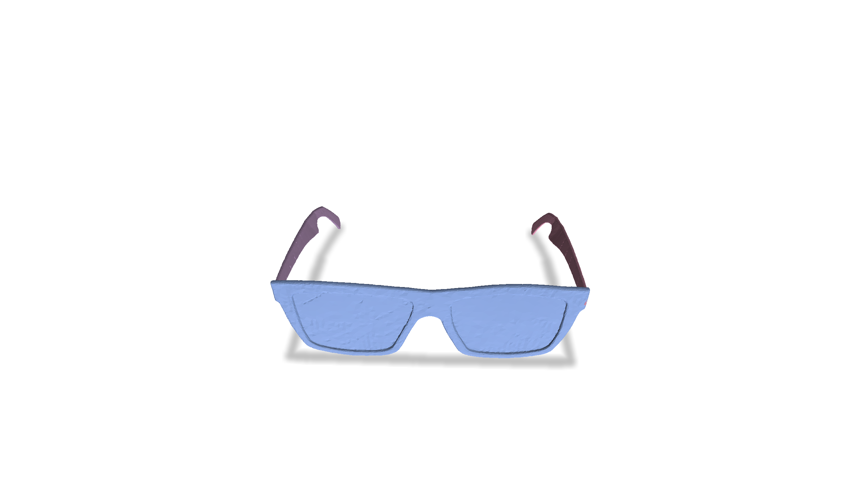
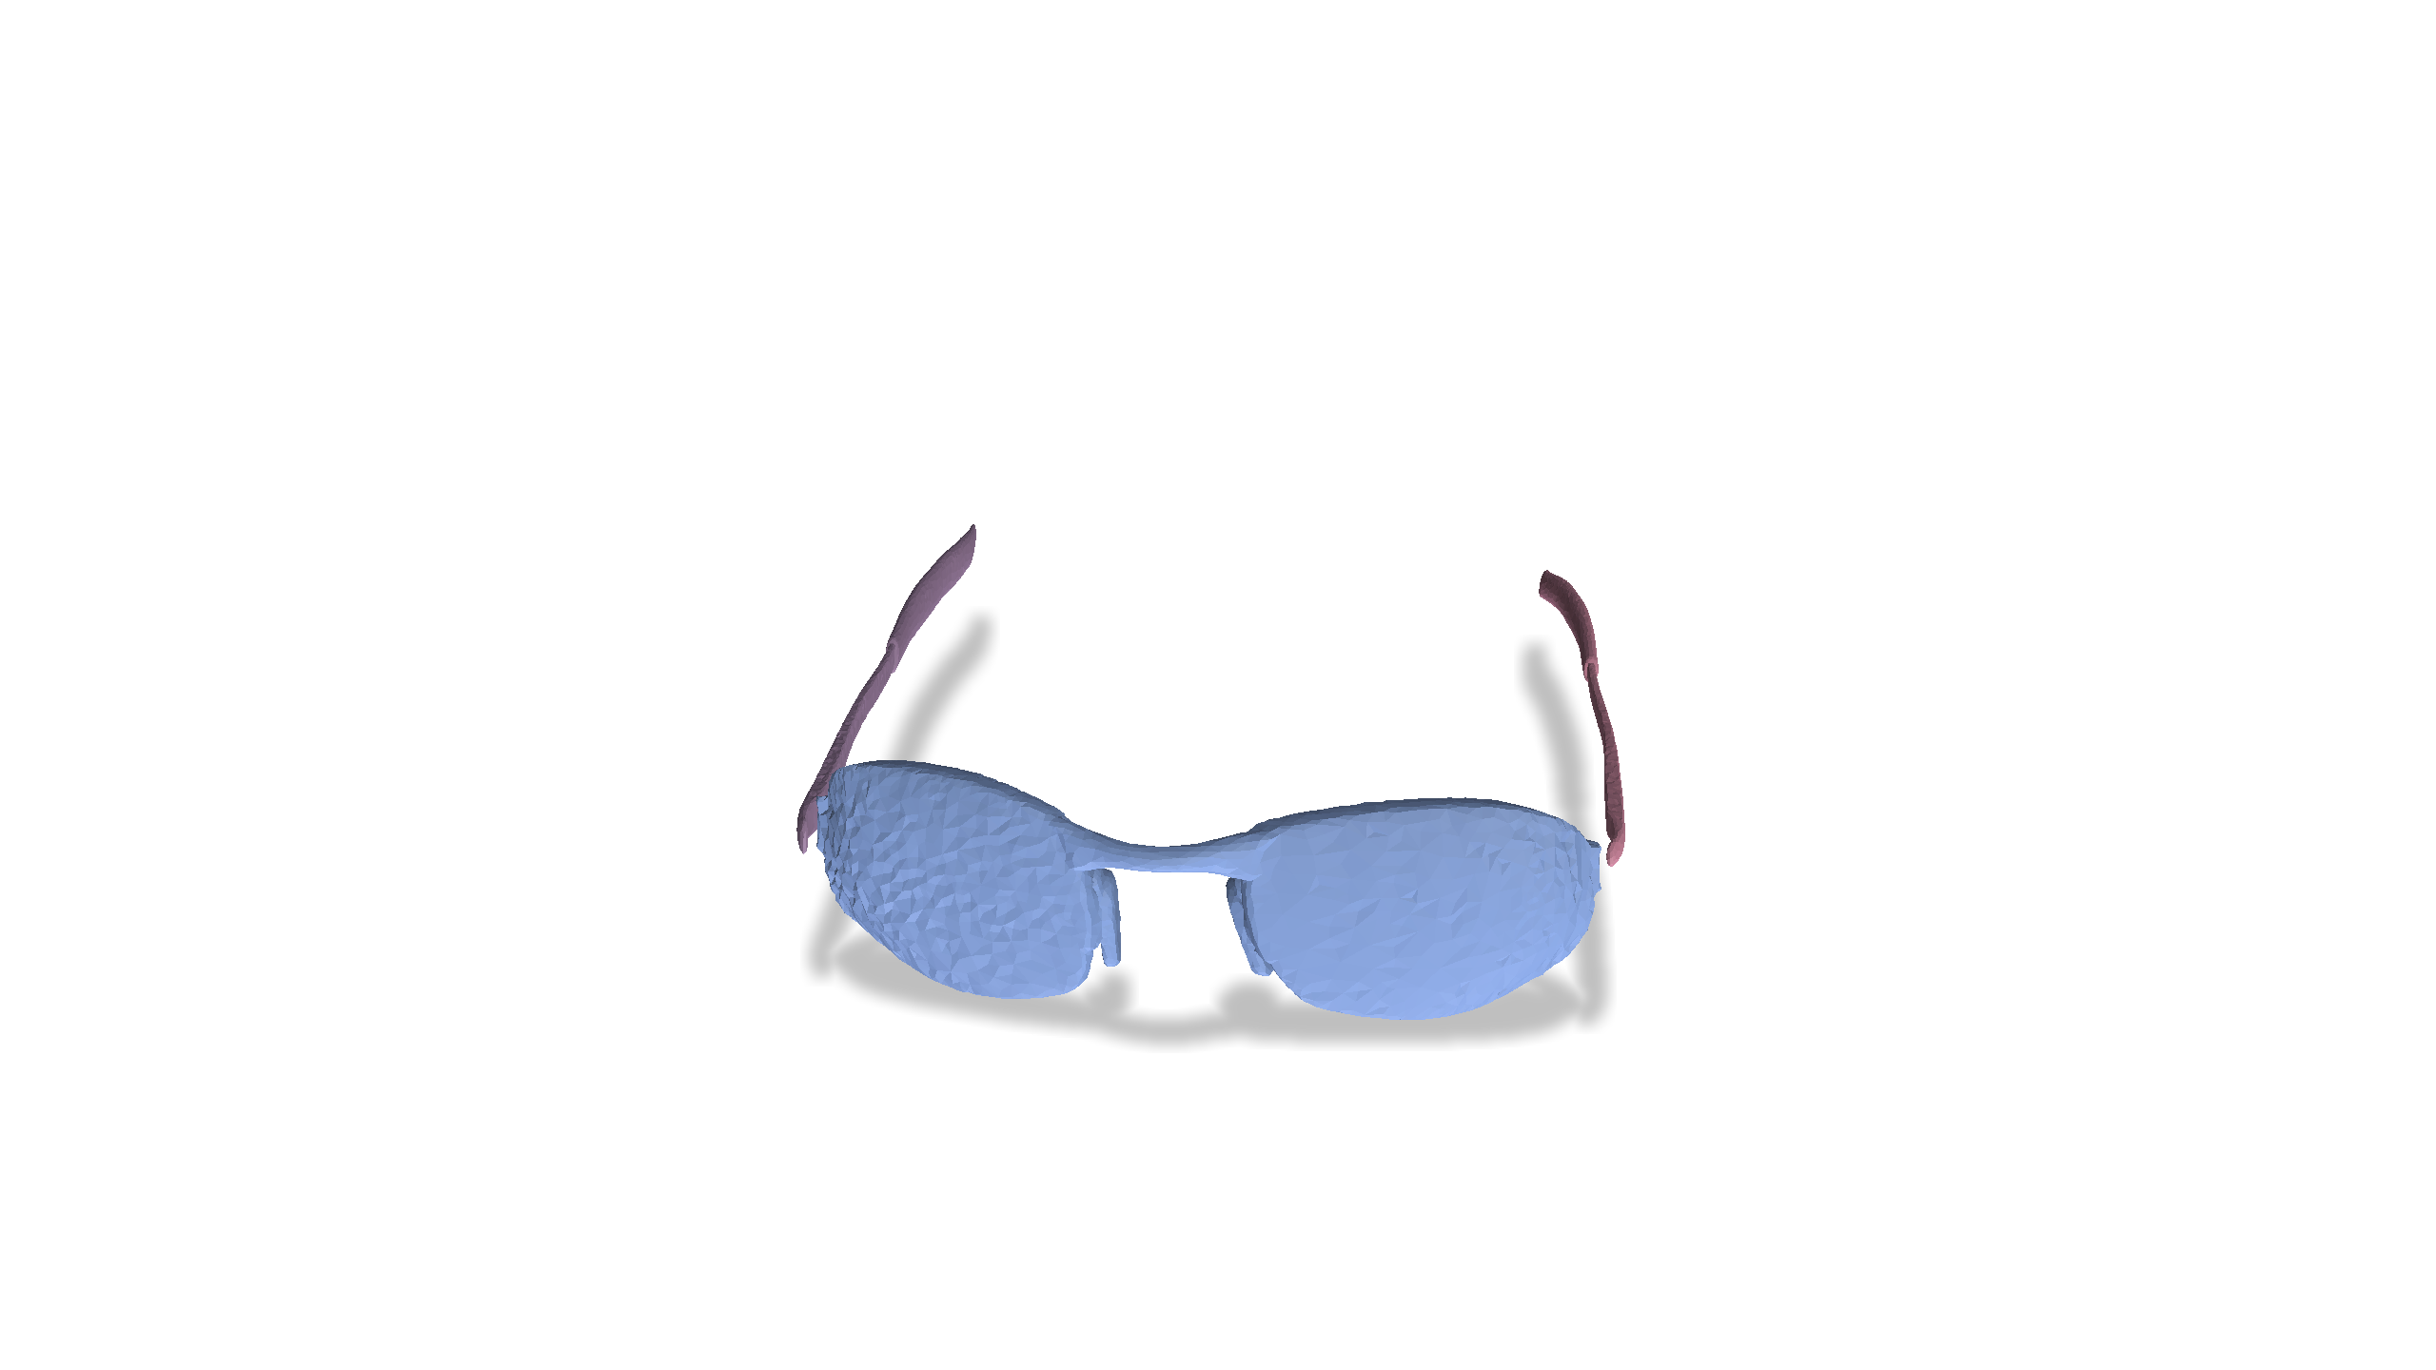
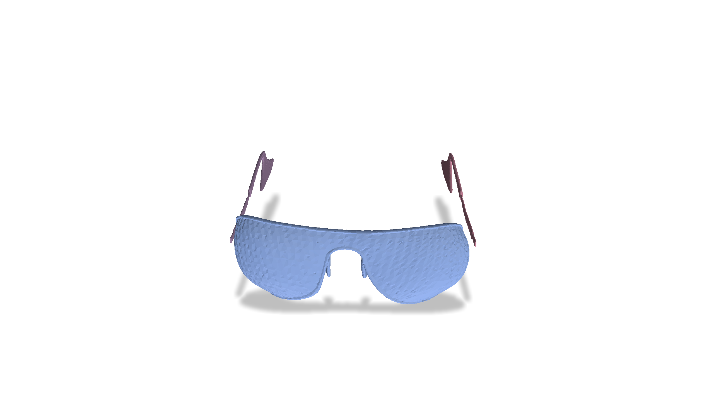
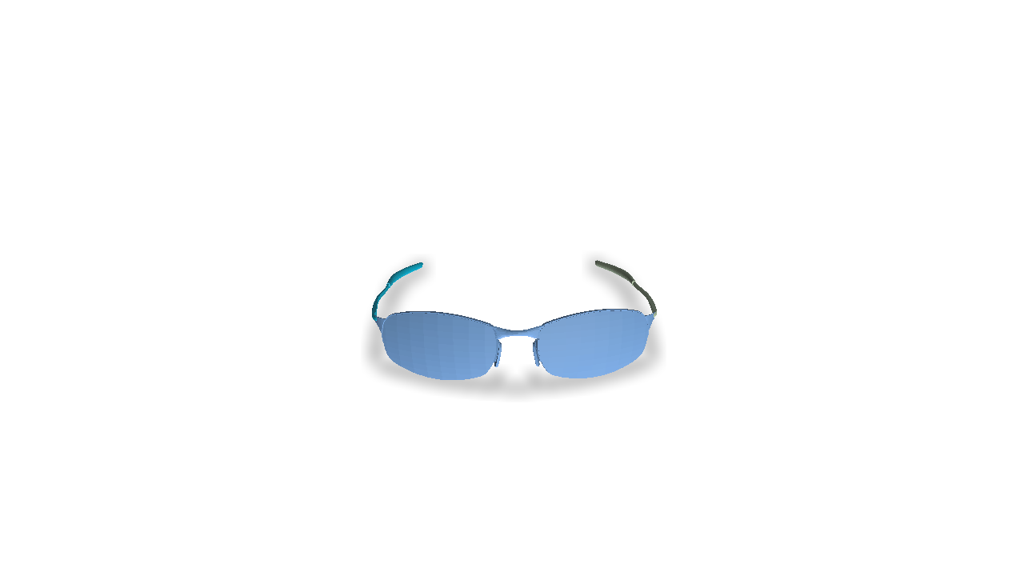
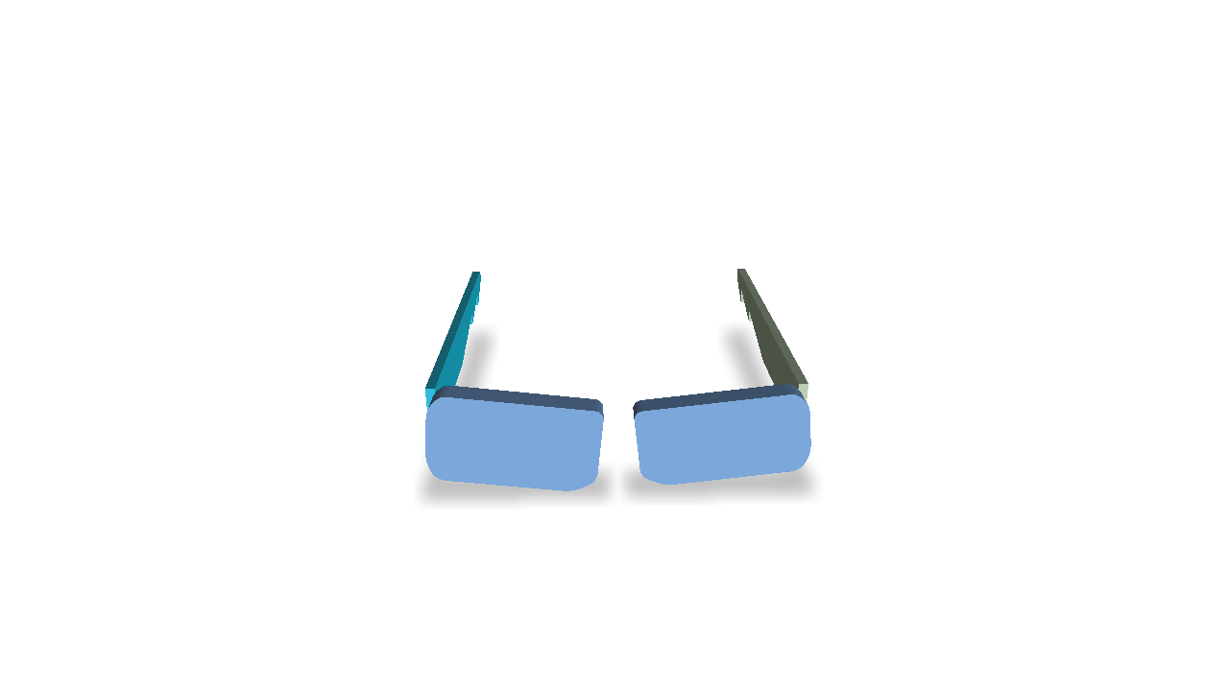
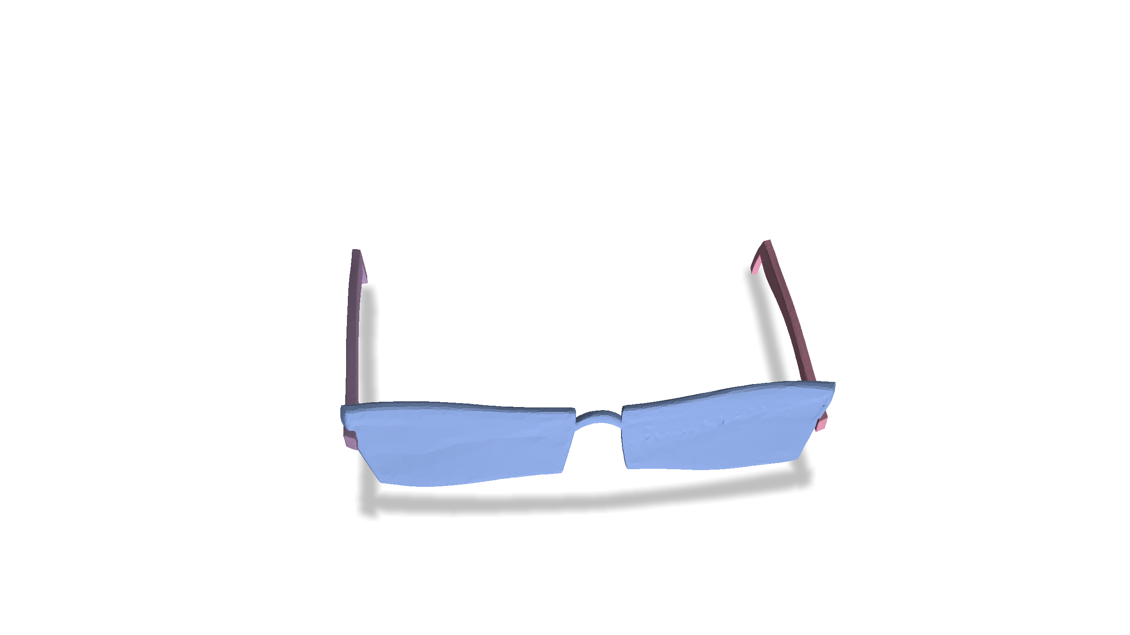
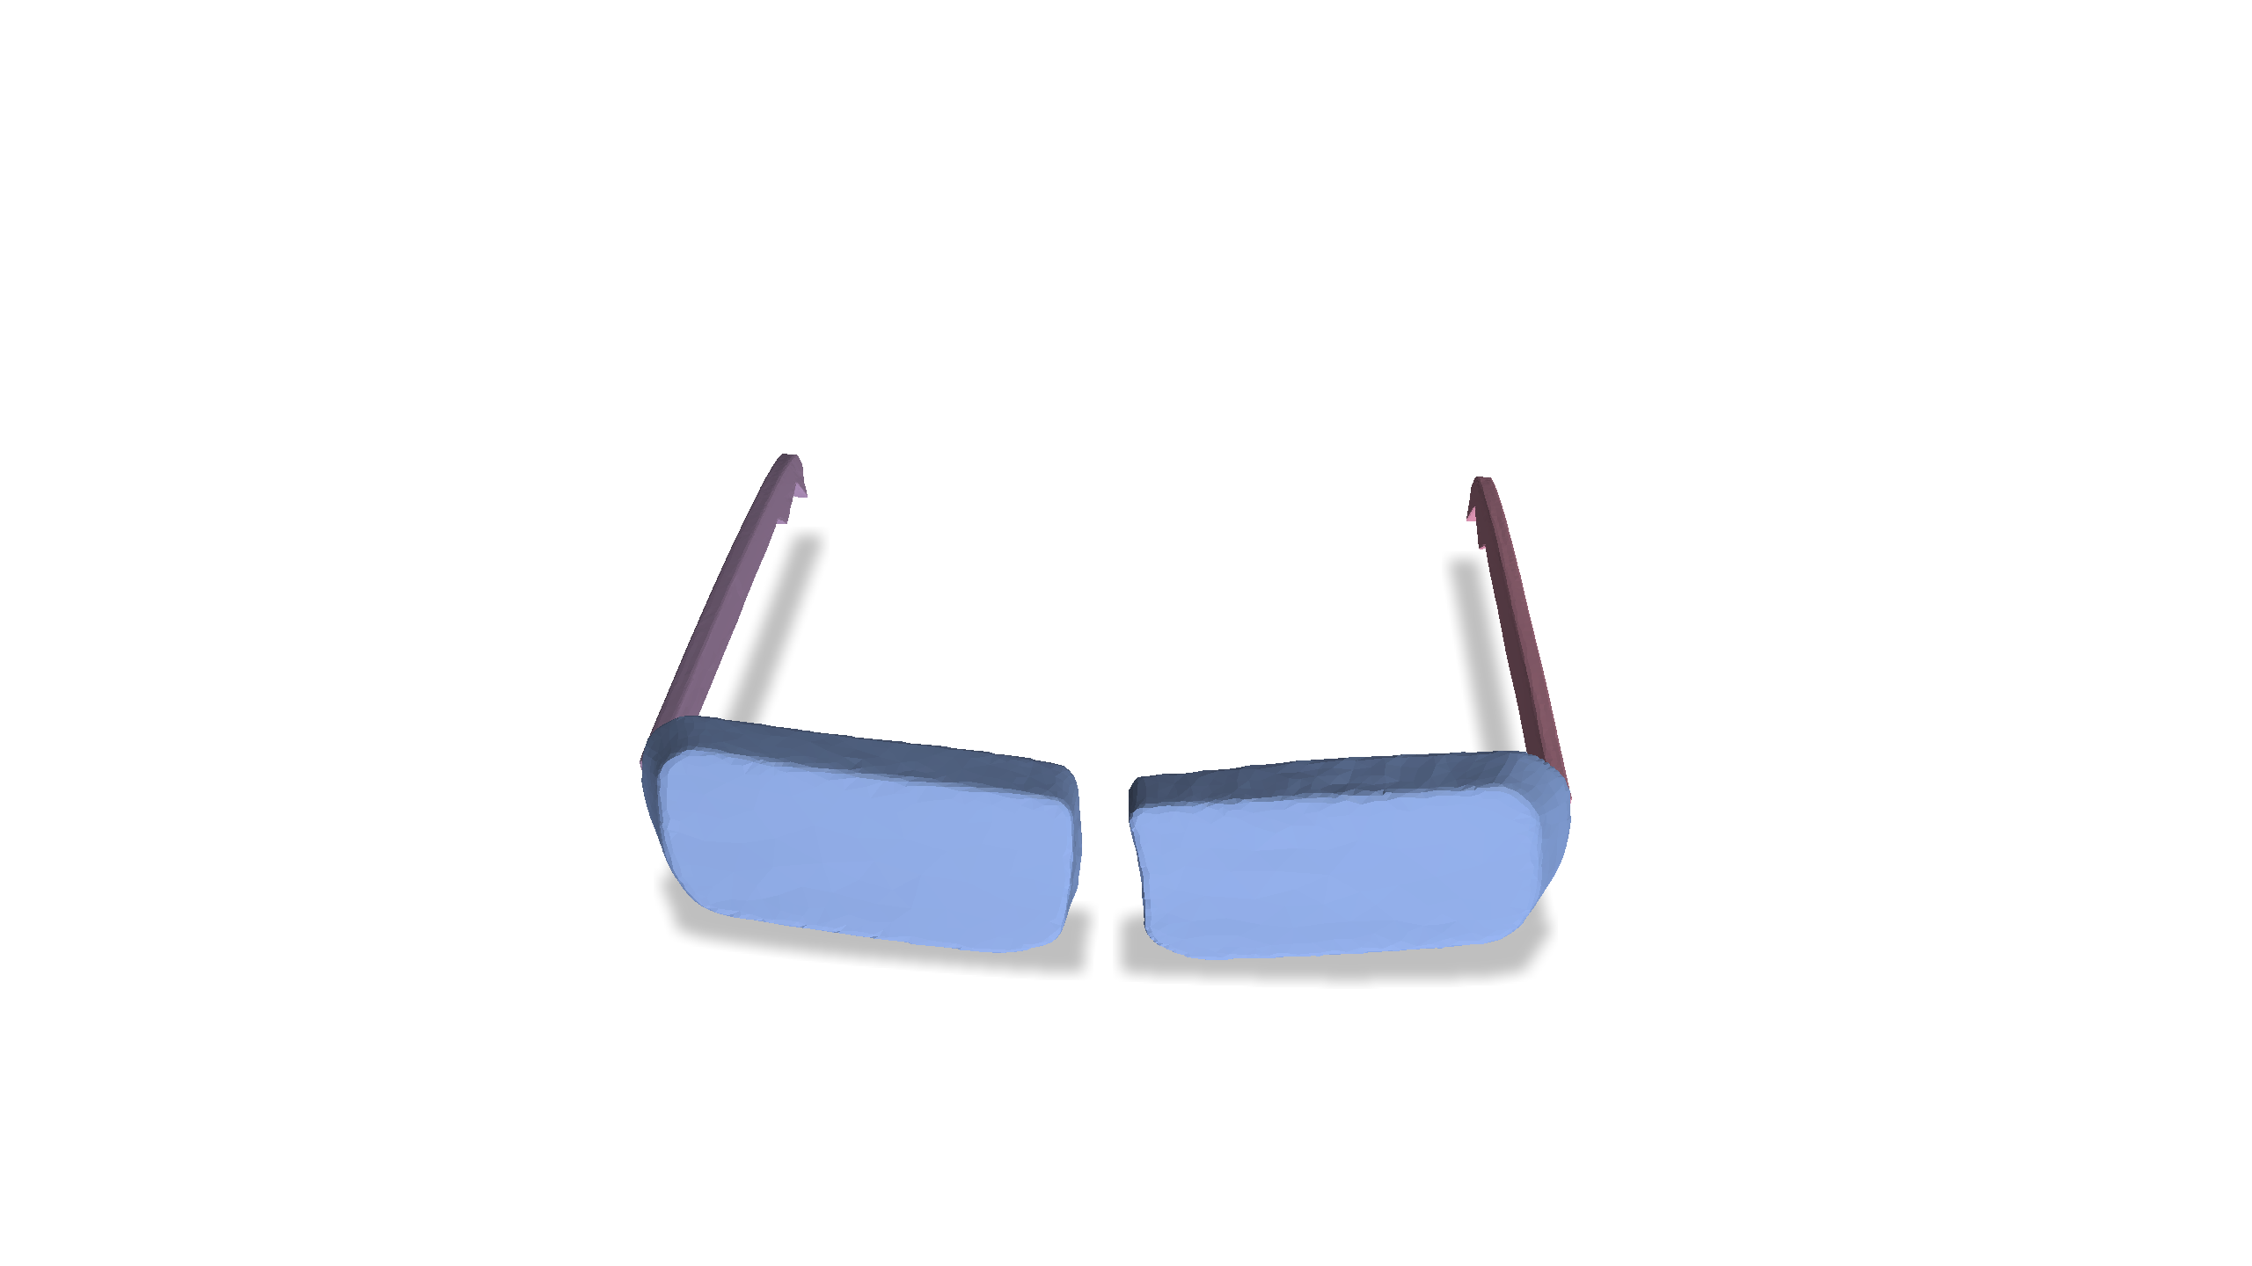
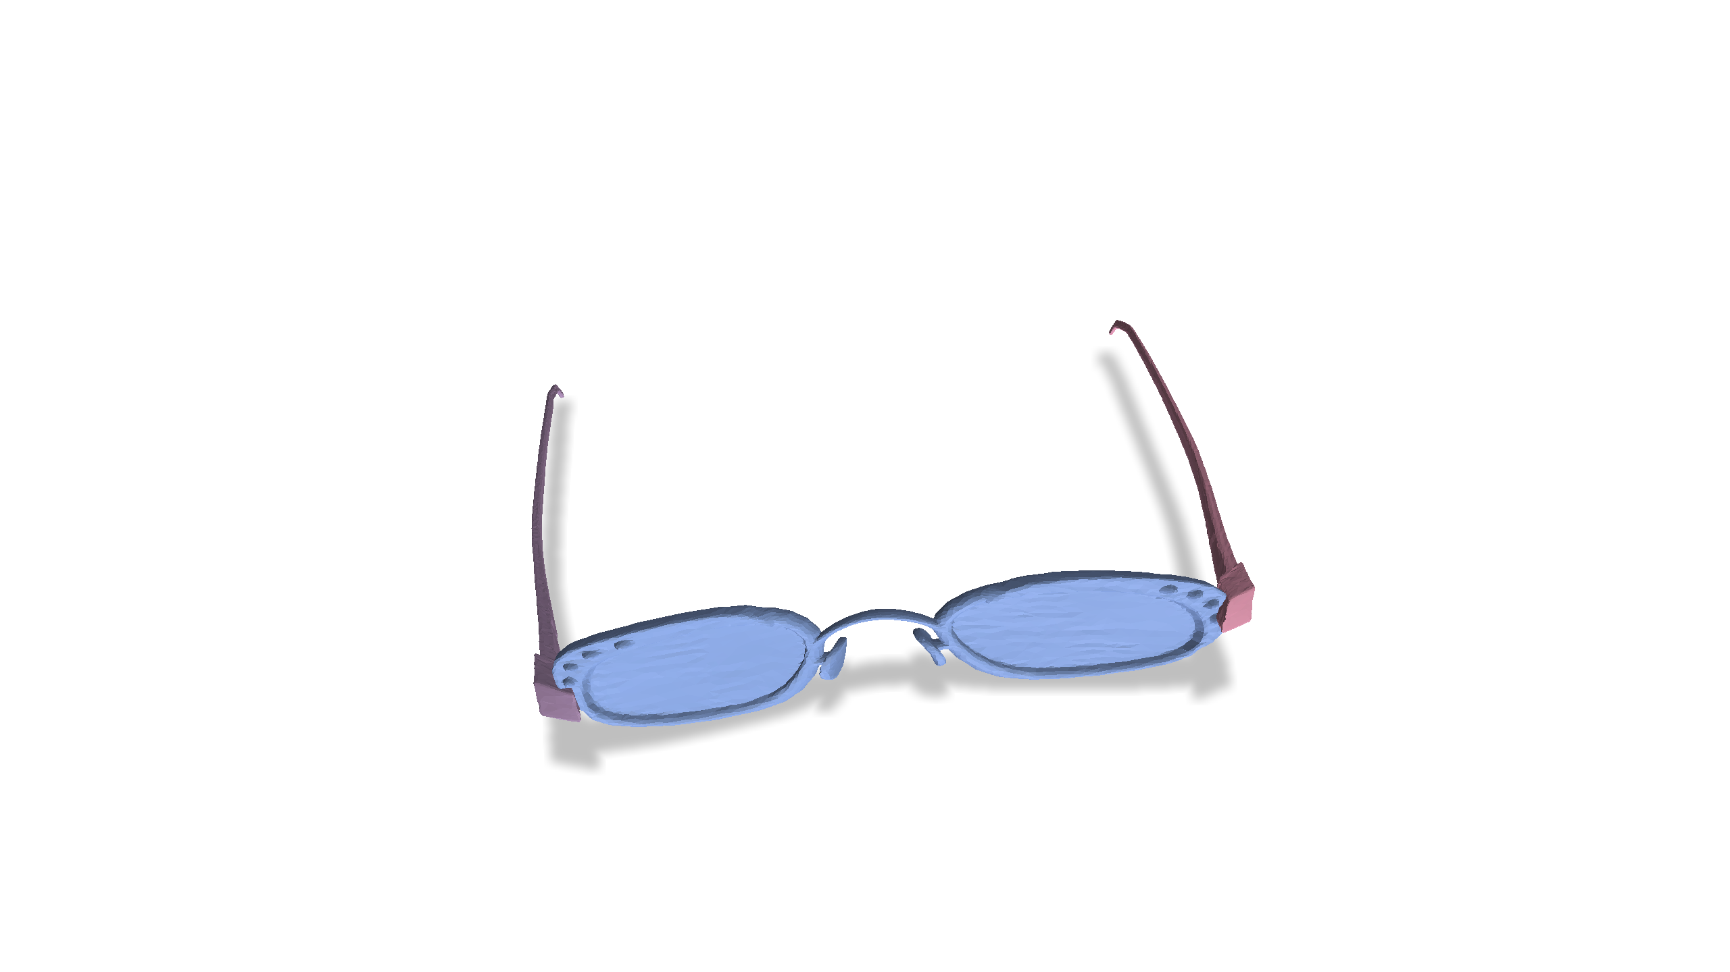
Problem Setting
Observed Examples
Diversity
Visual Quality
Notes:
This naturally points us to devise a generative model that can generate articulated meshes with diverse geometry, high visual fidelity, and also correct physics to support physically-realistic simulation.

Slide 5
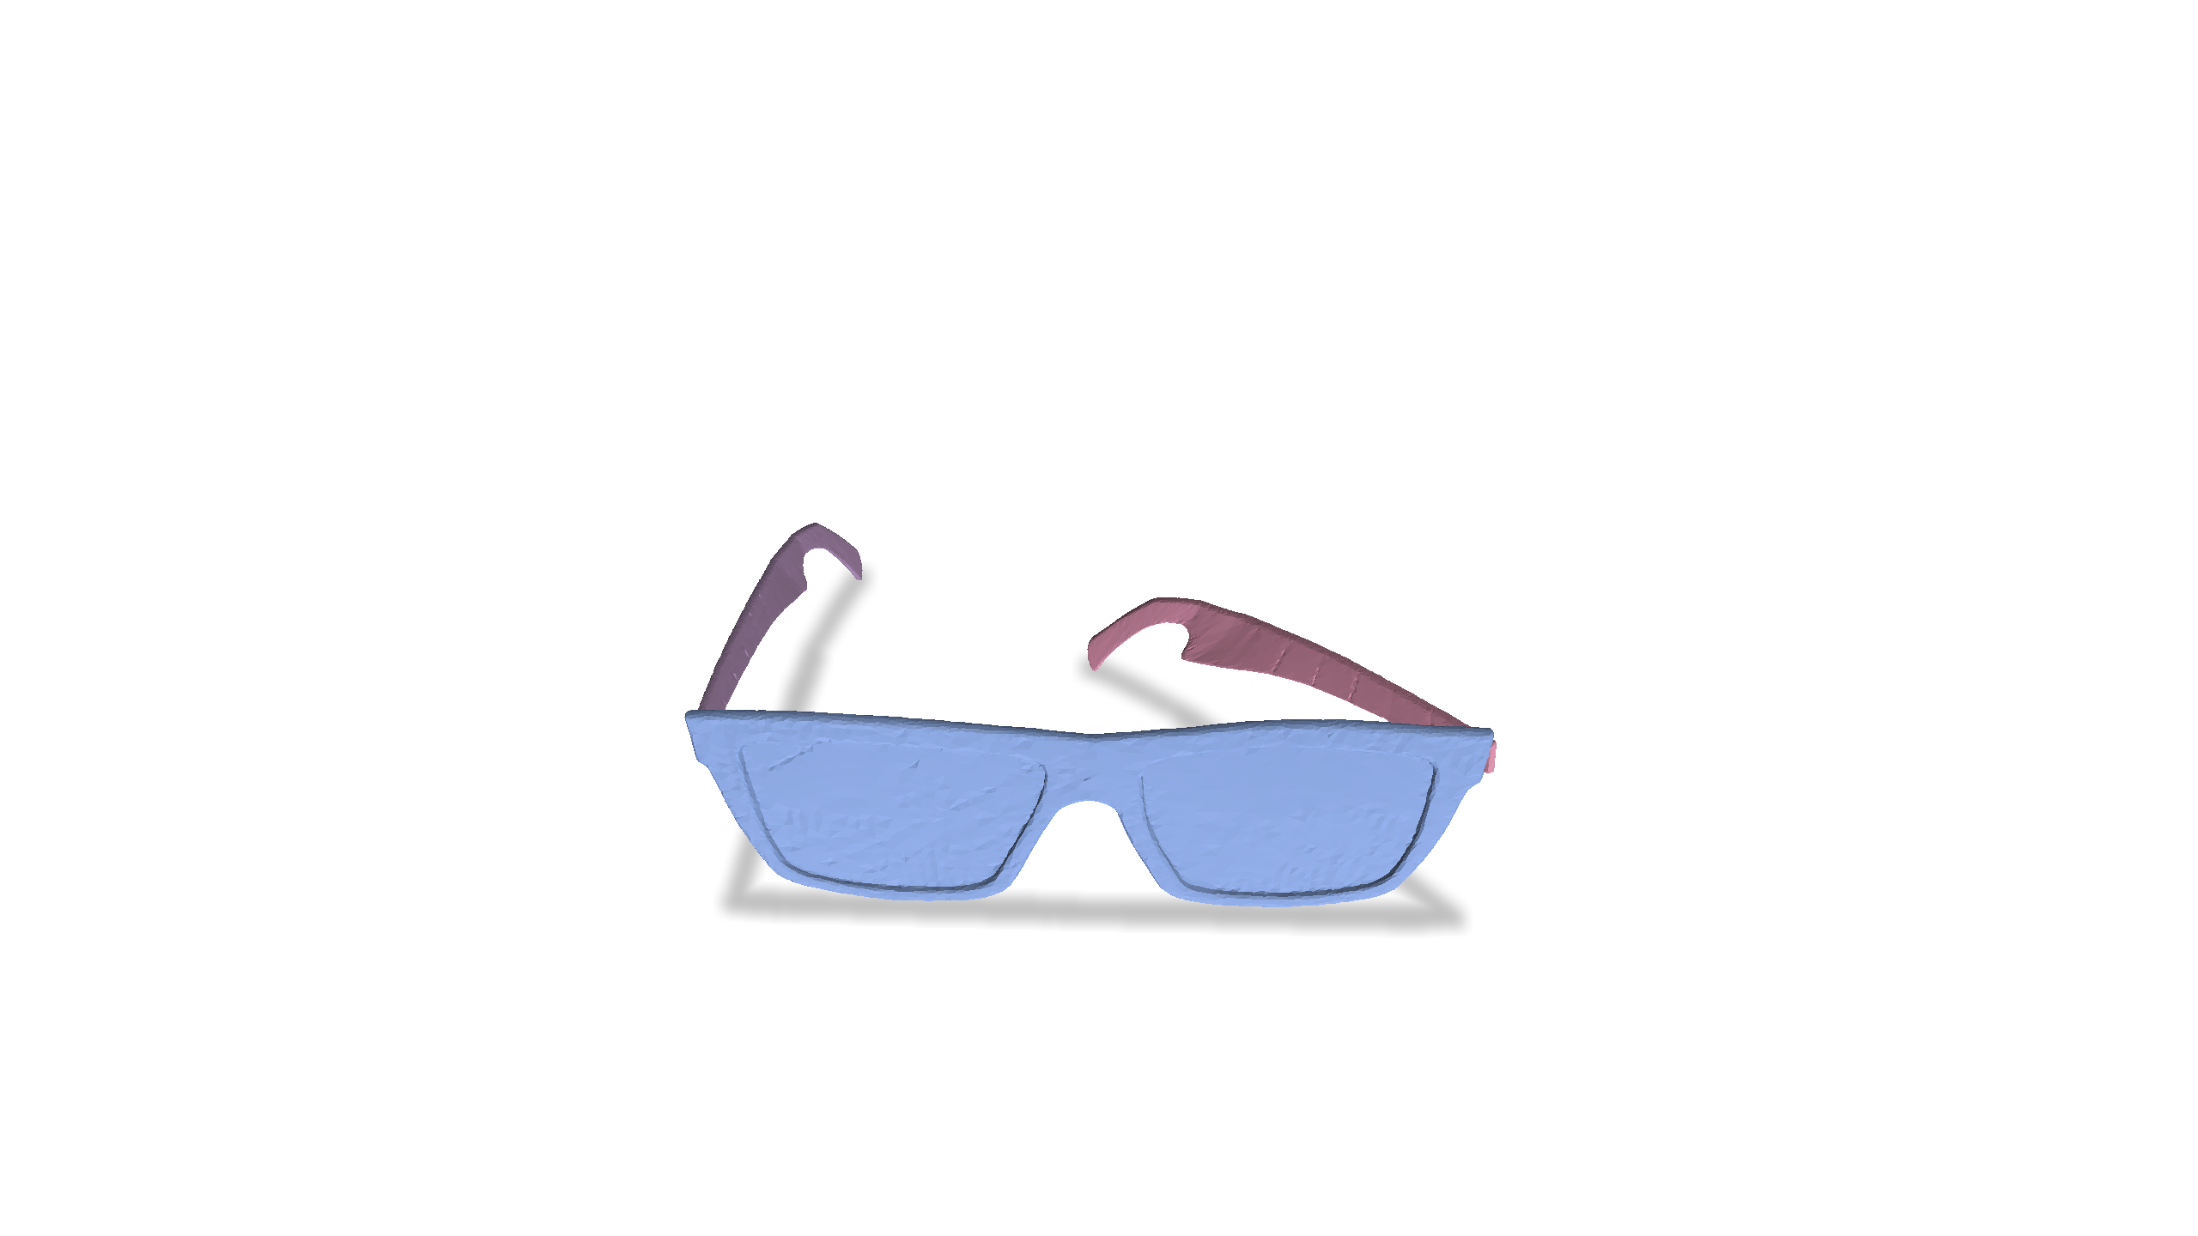
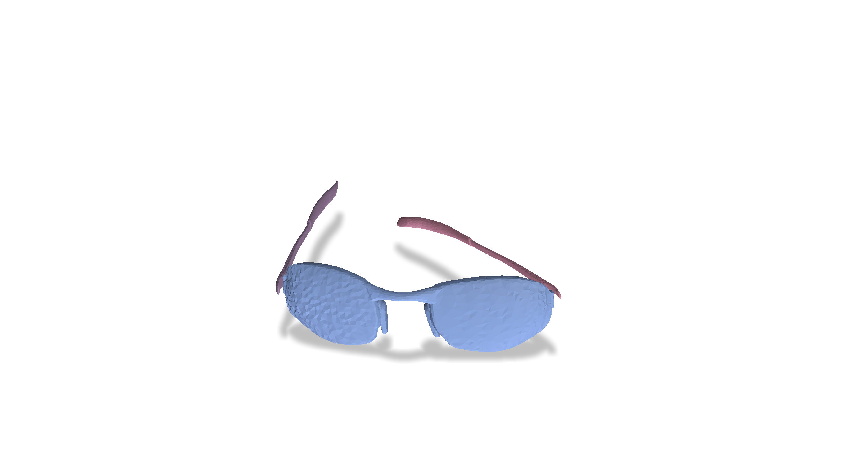
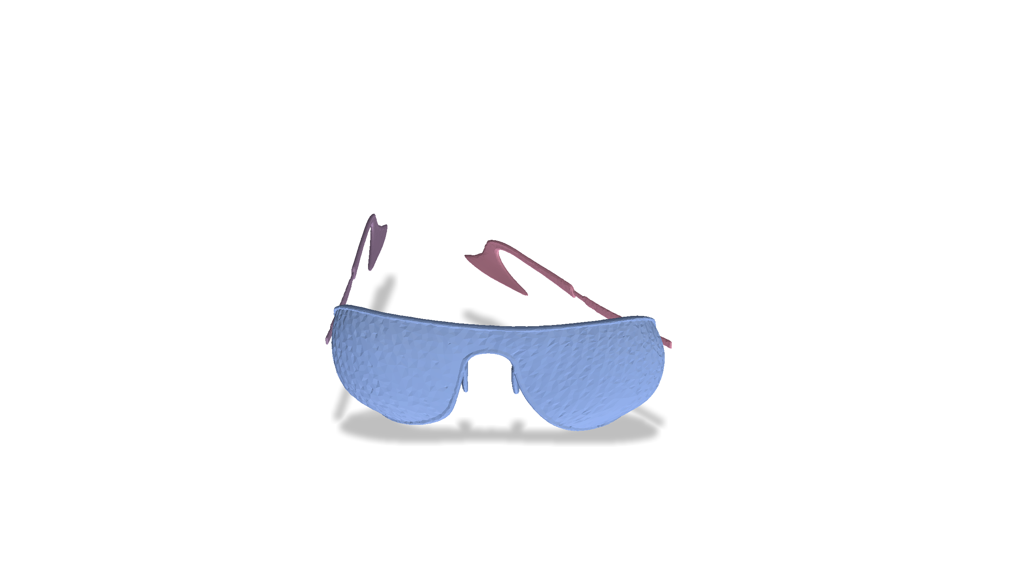
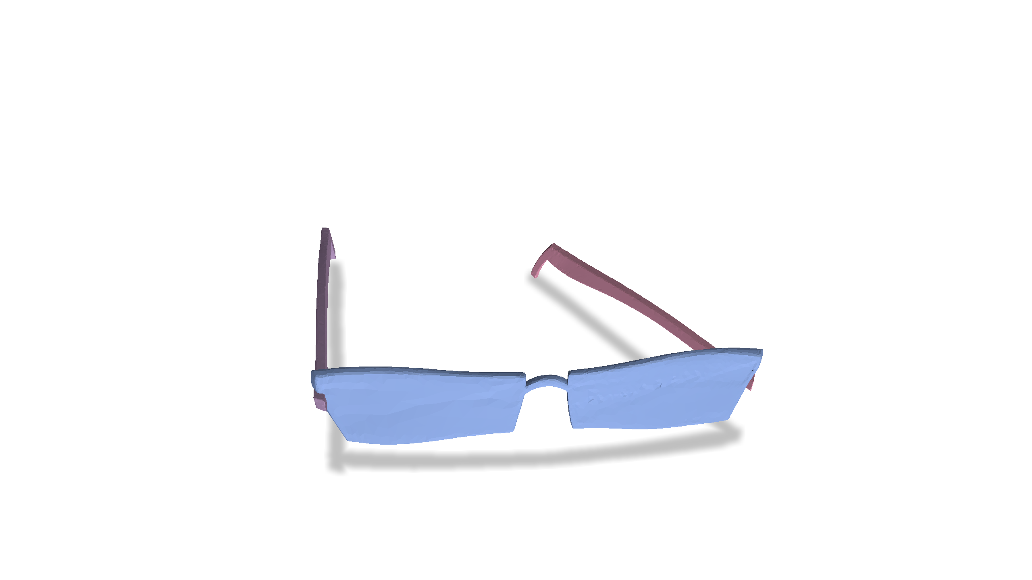
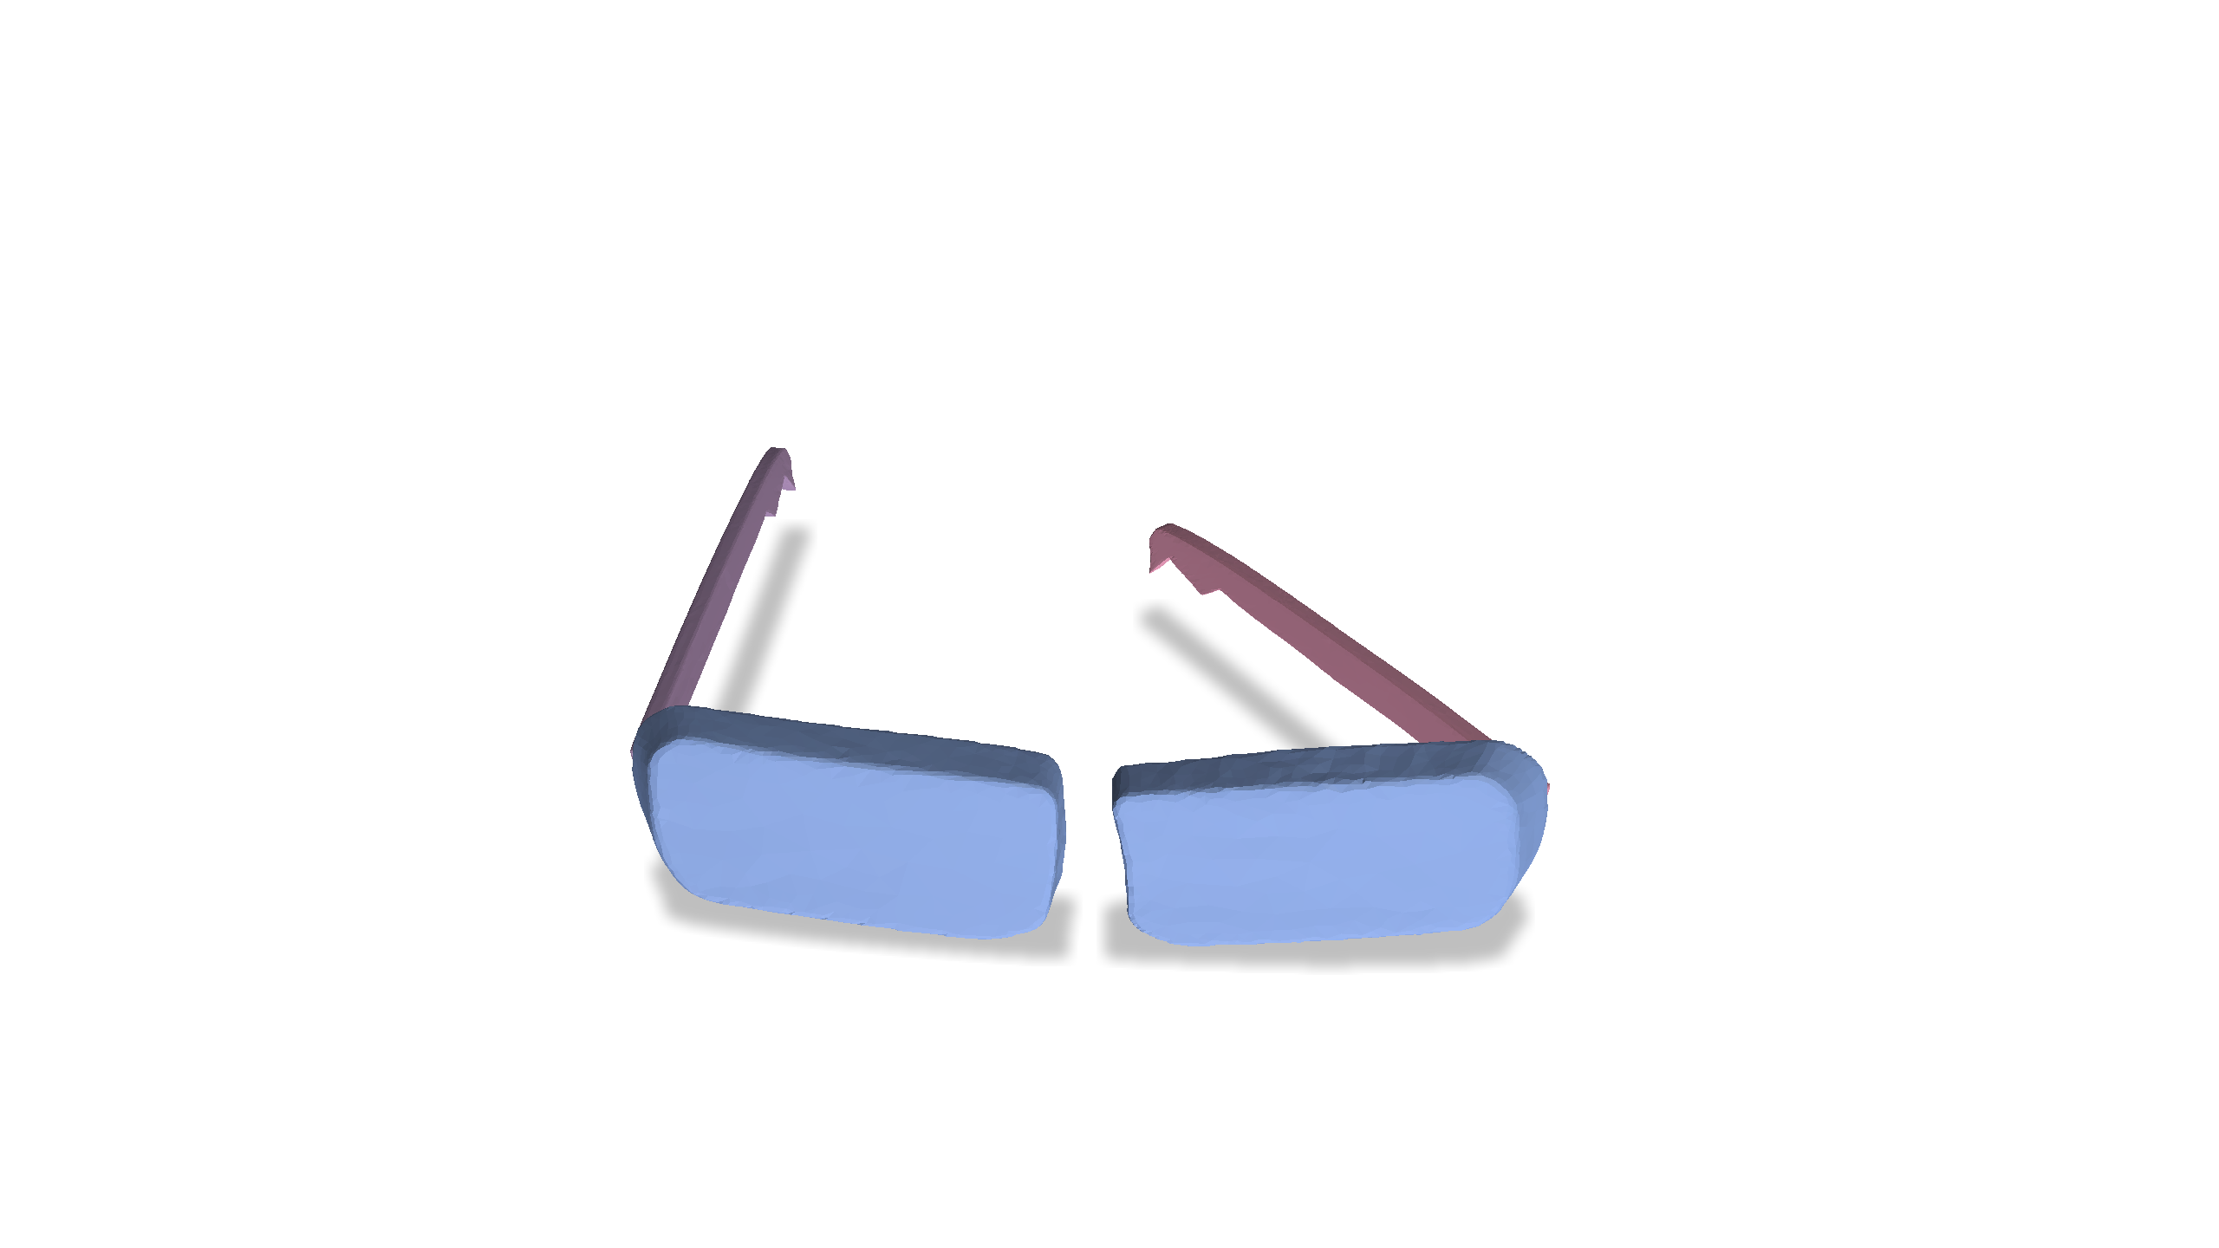
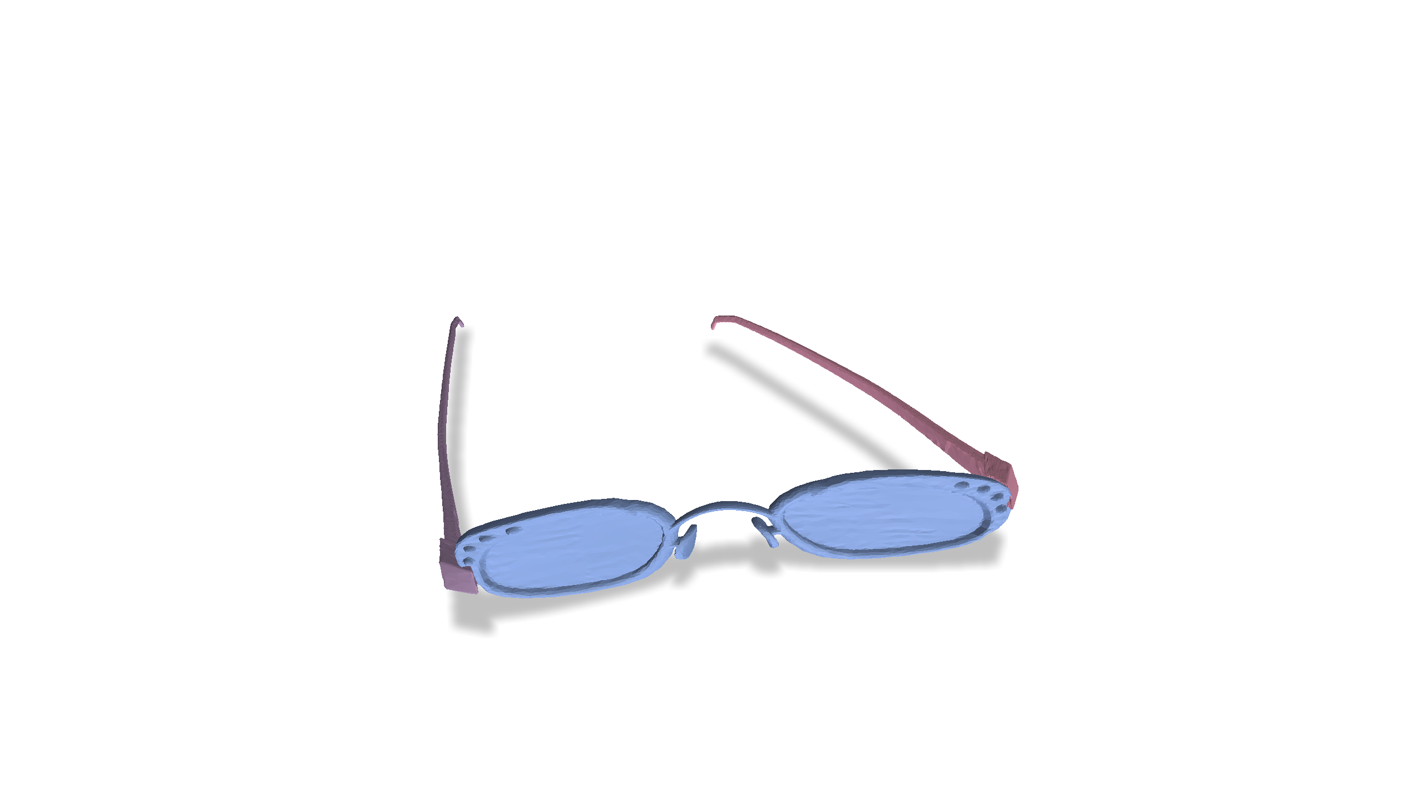
Problem Setting
Observed Examples
Simulation Timestep $t_{1}$

Slide 6
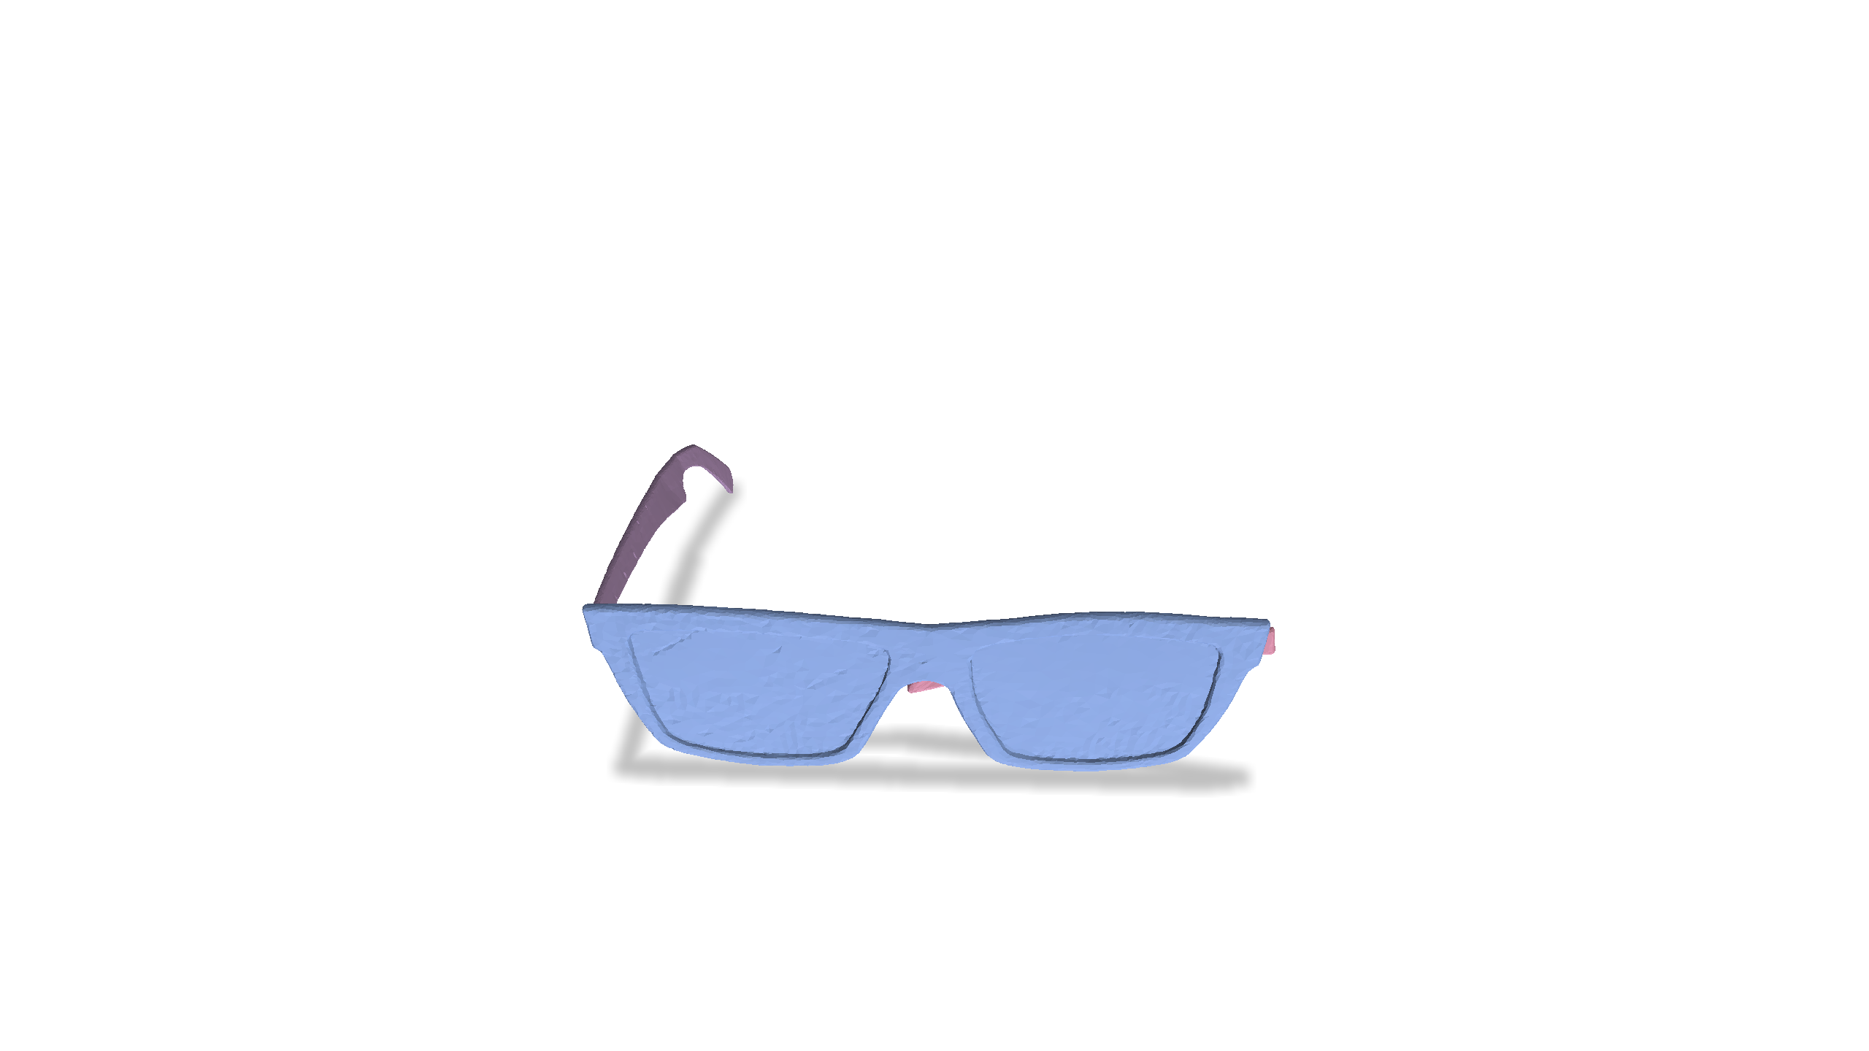
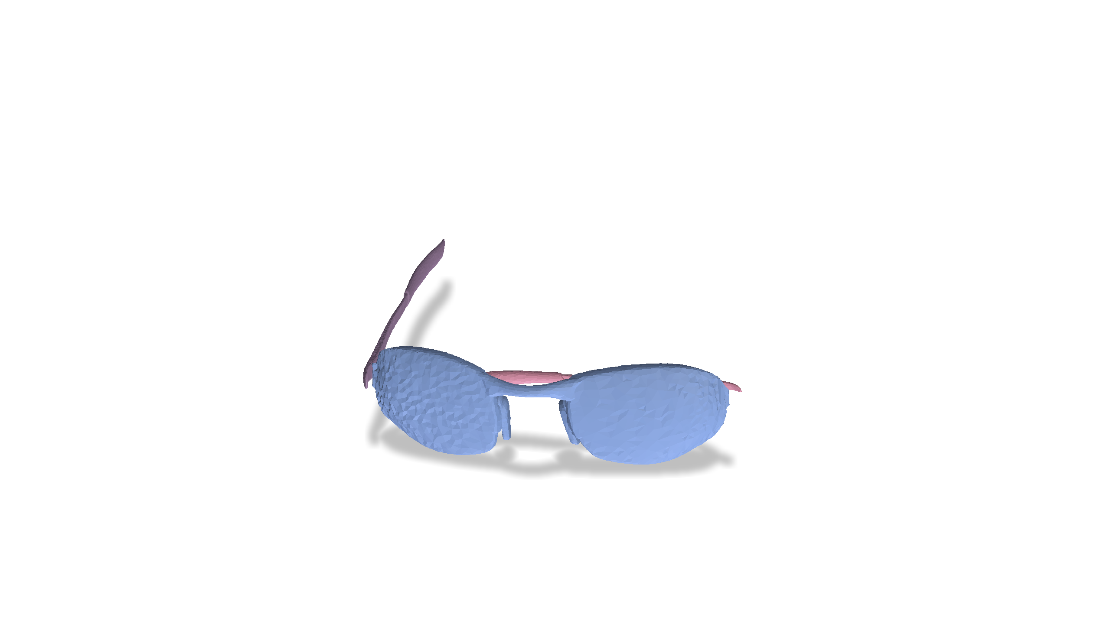
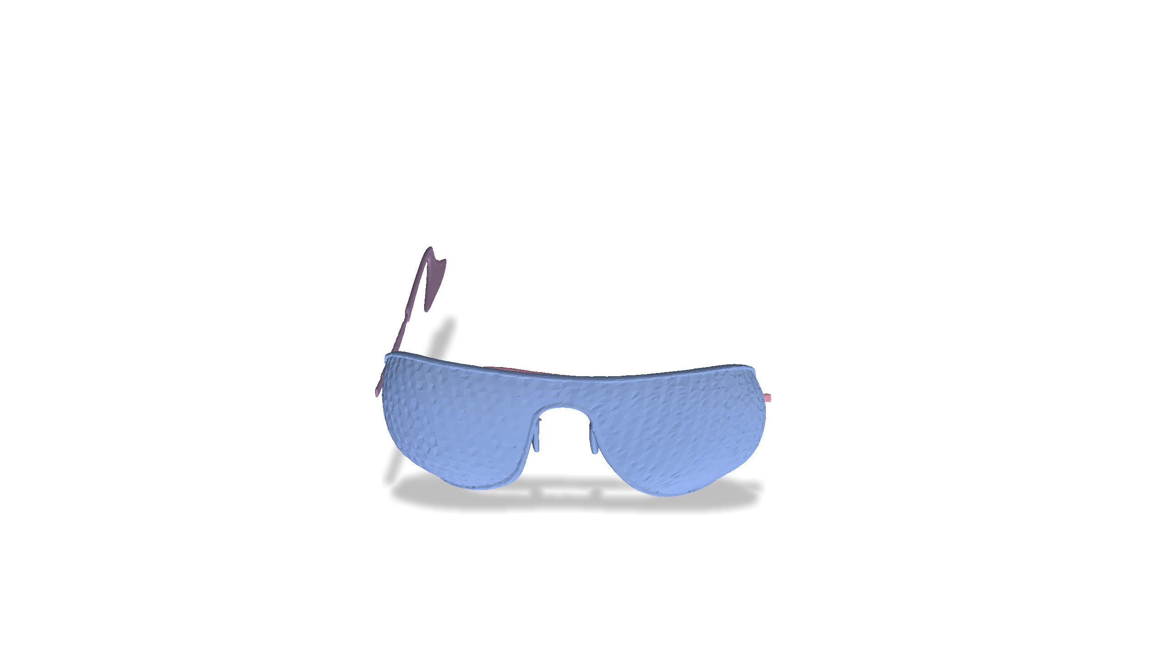
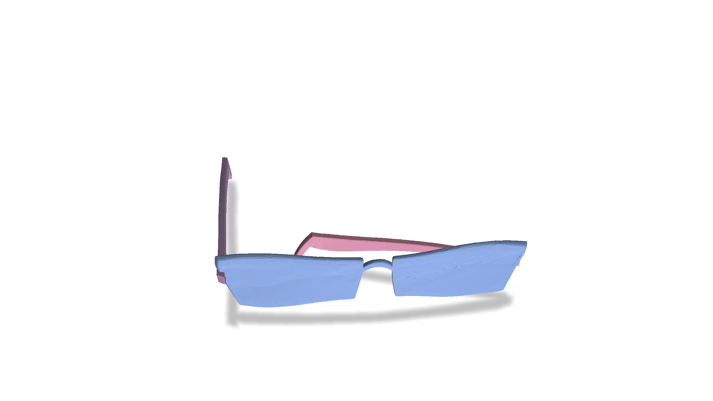
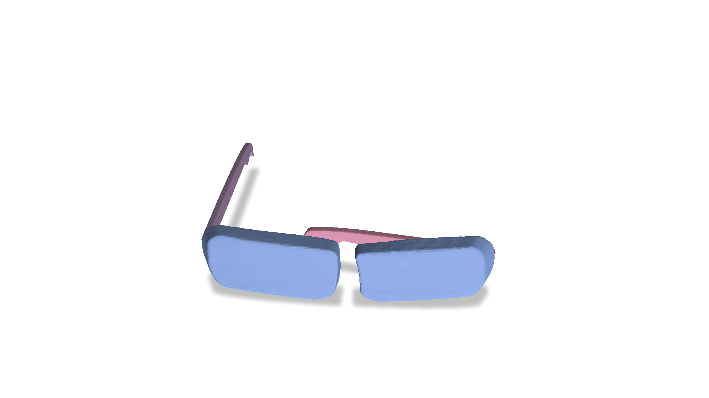
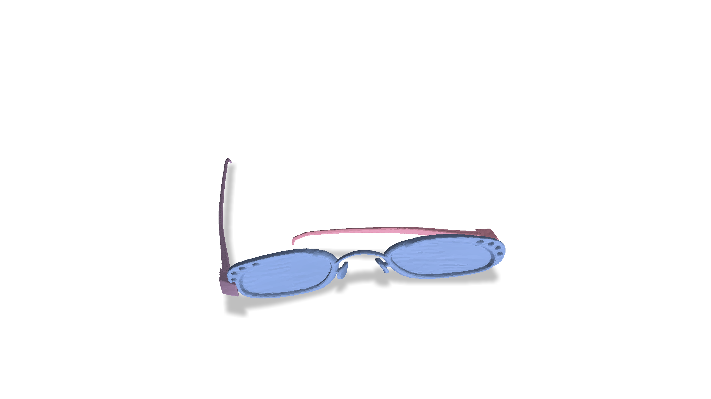
Problem Setting
Observed Examples
Simulation Timestep $t_{2}$

Slide 7
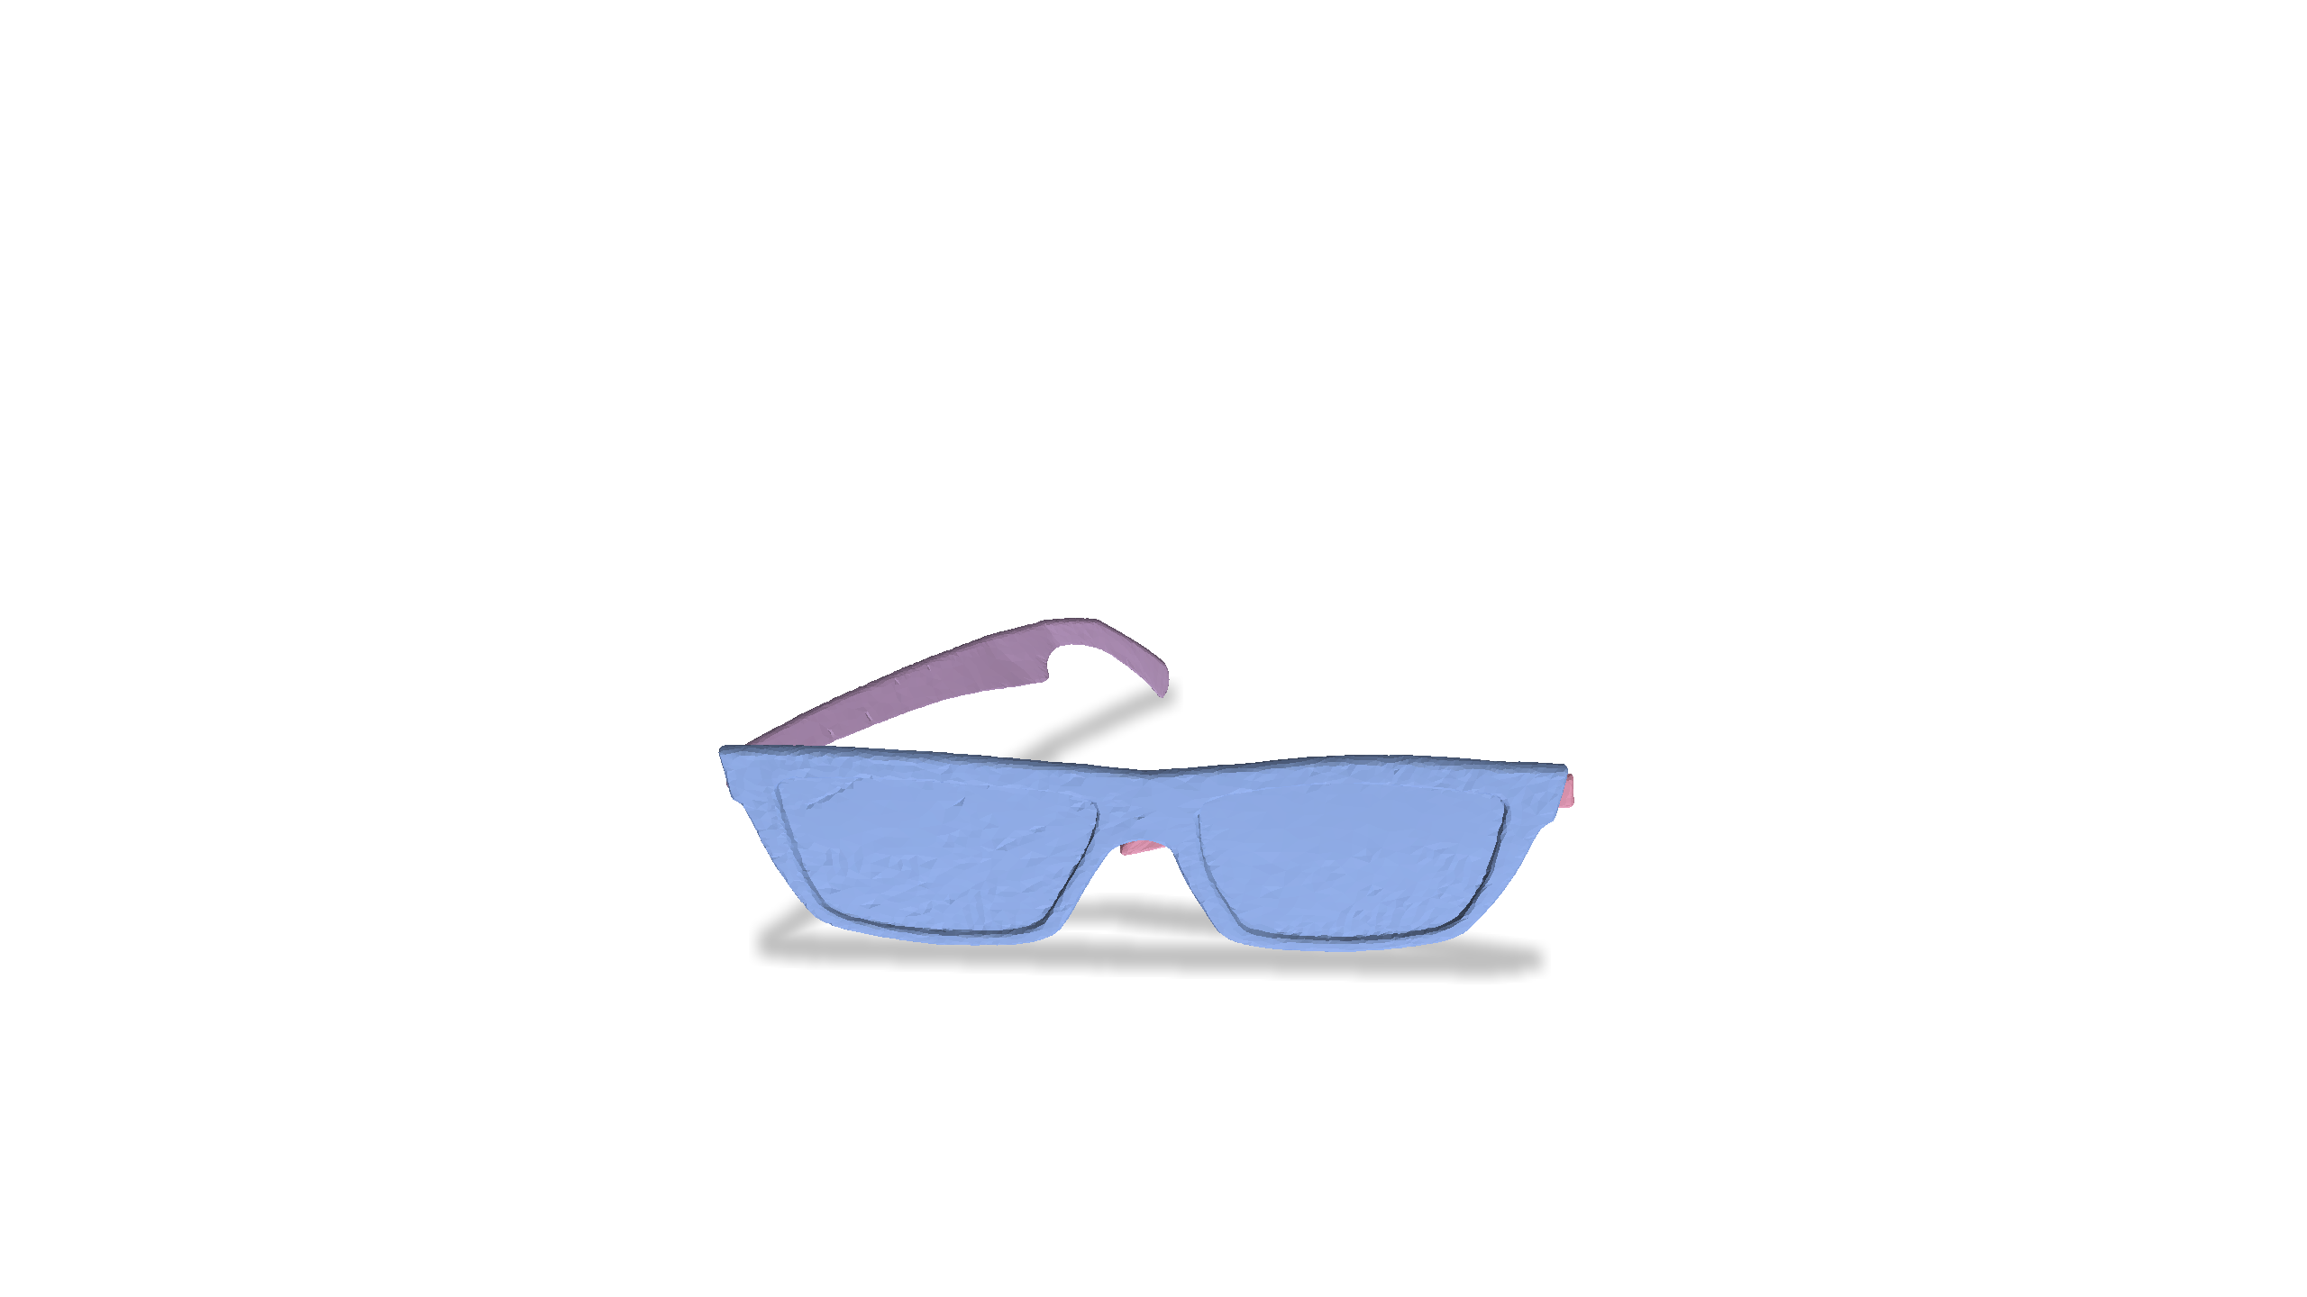
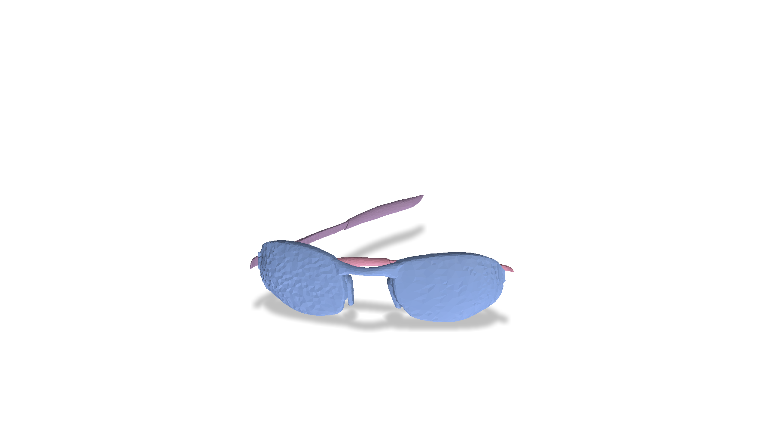
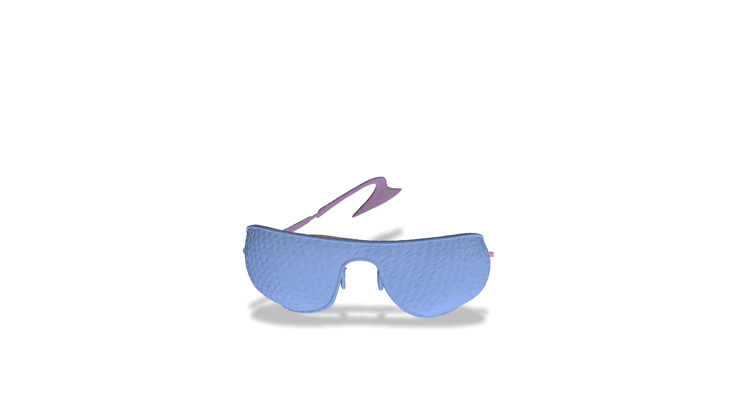
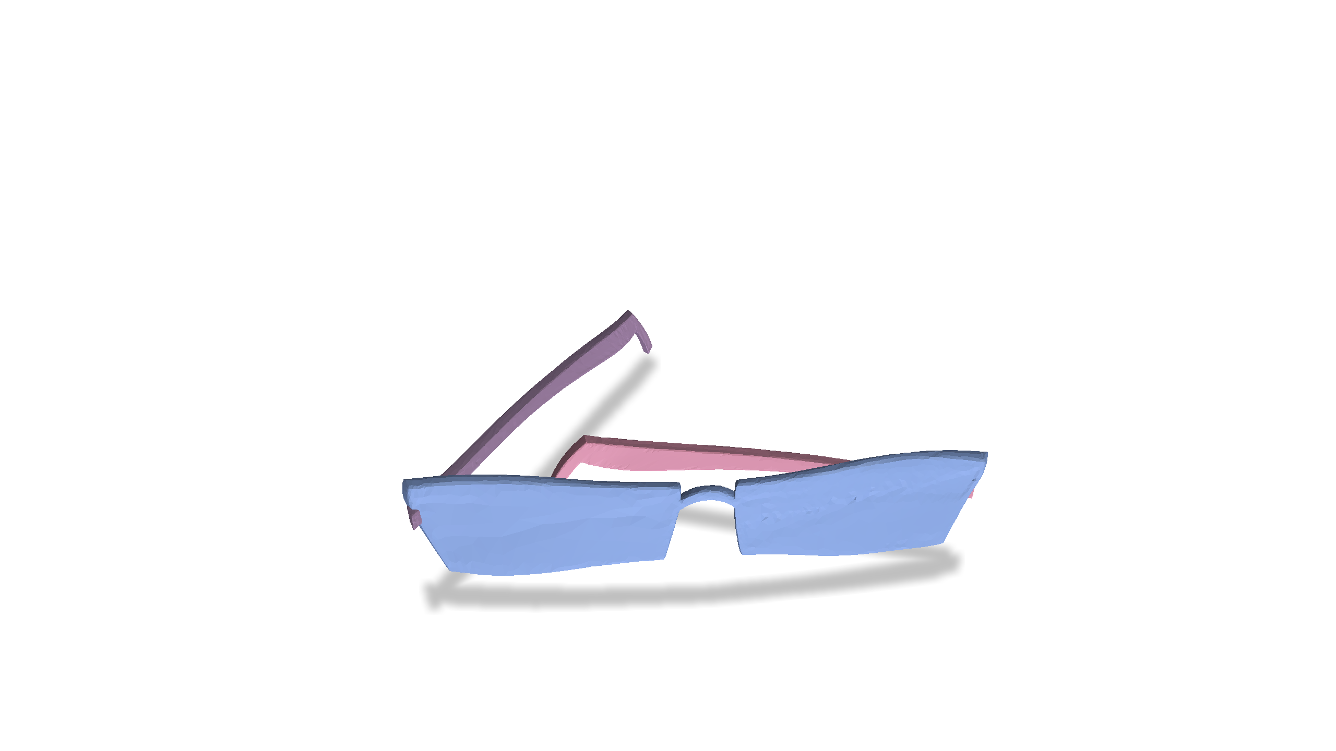
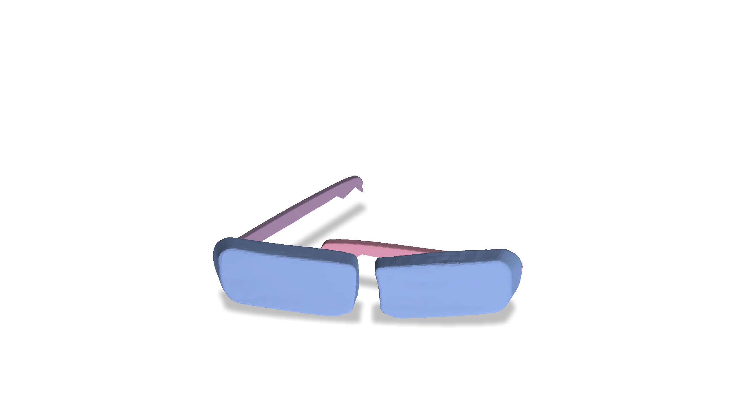
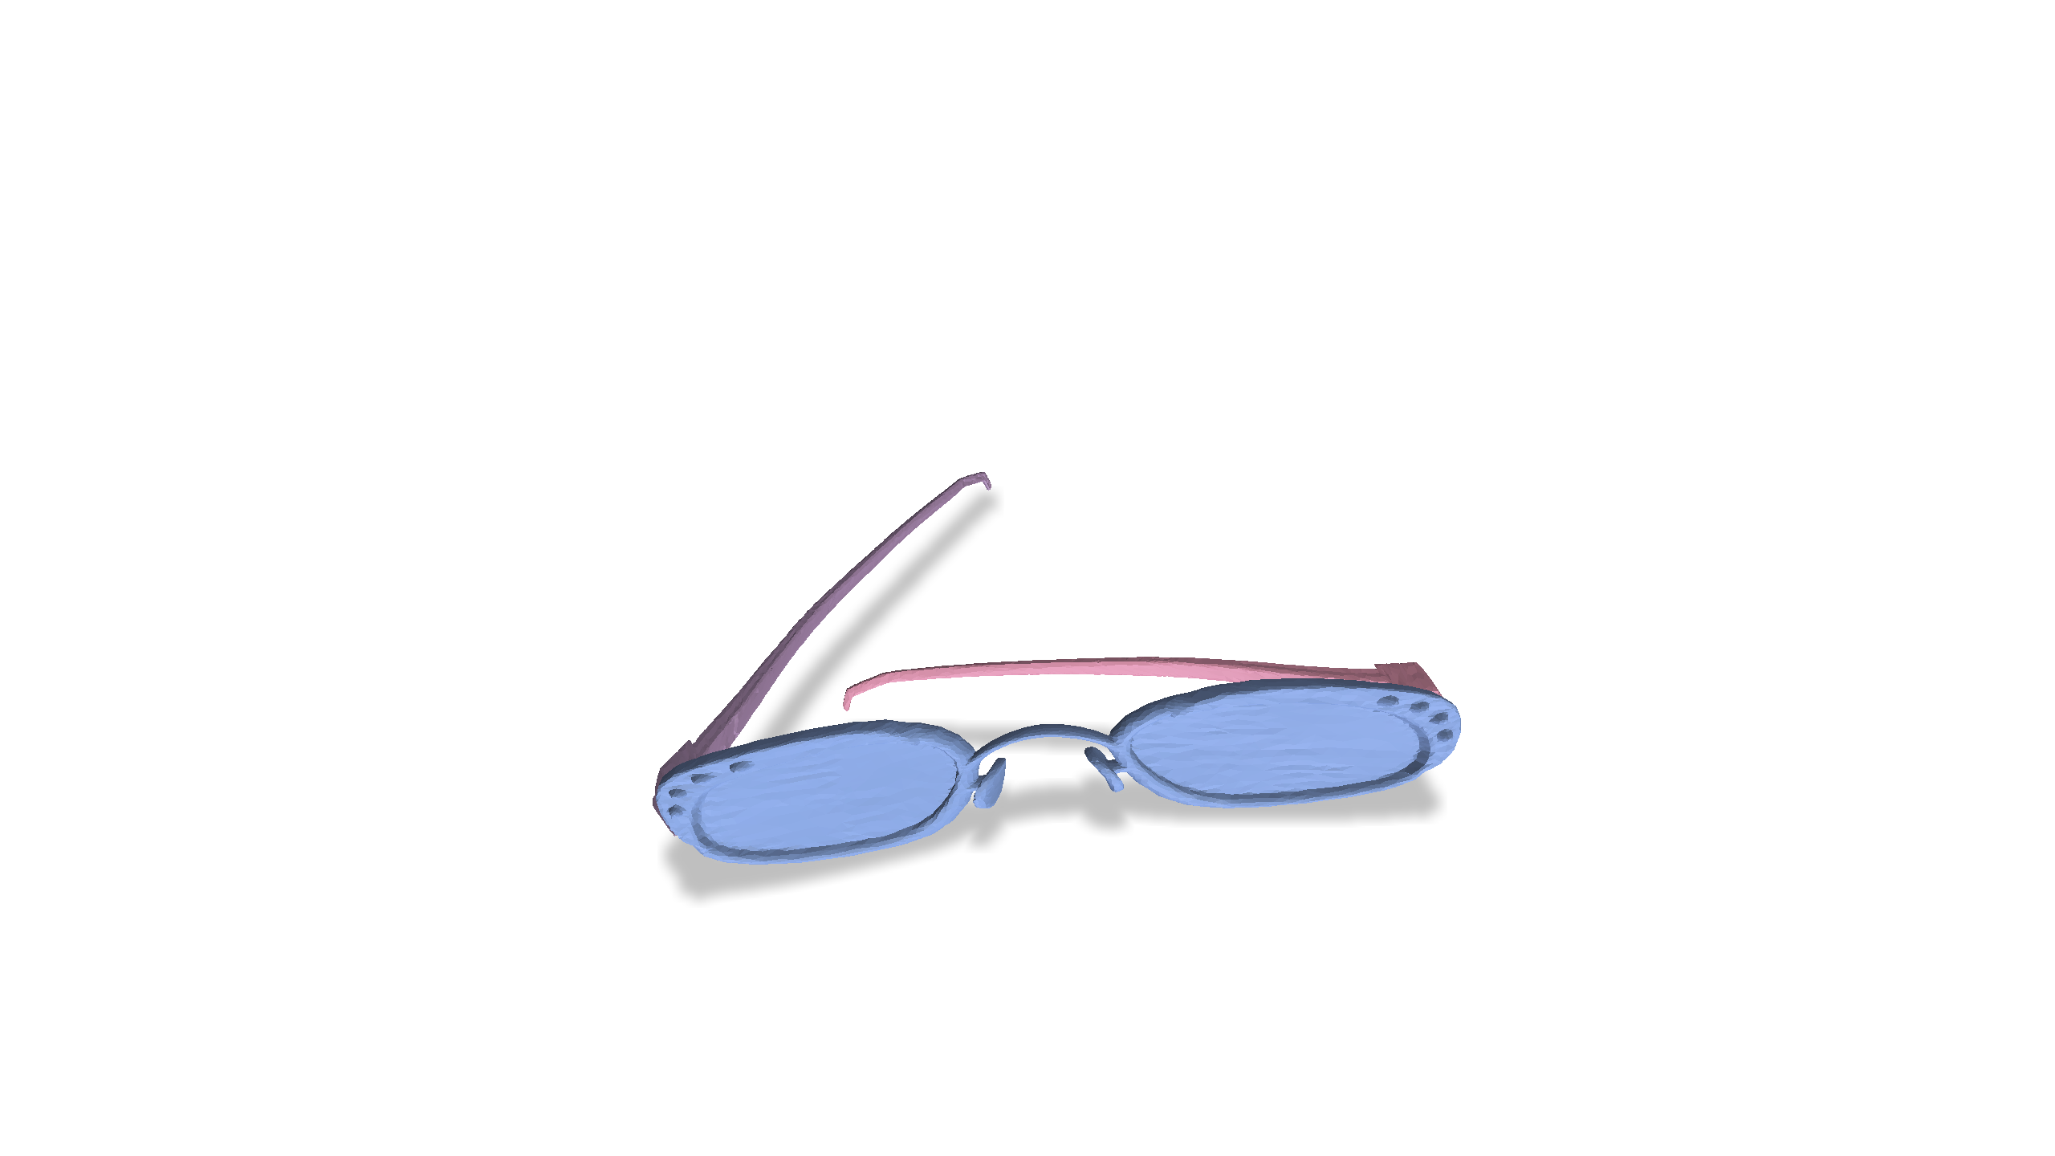
Problem Setting
Observed Examples
Simulation Timestep $t_{3}$

Slide 8
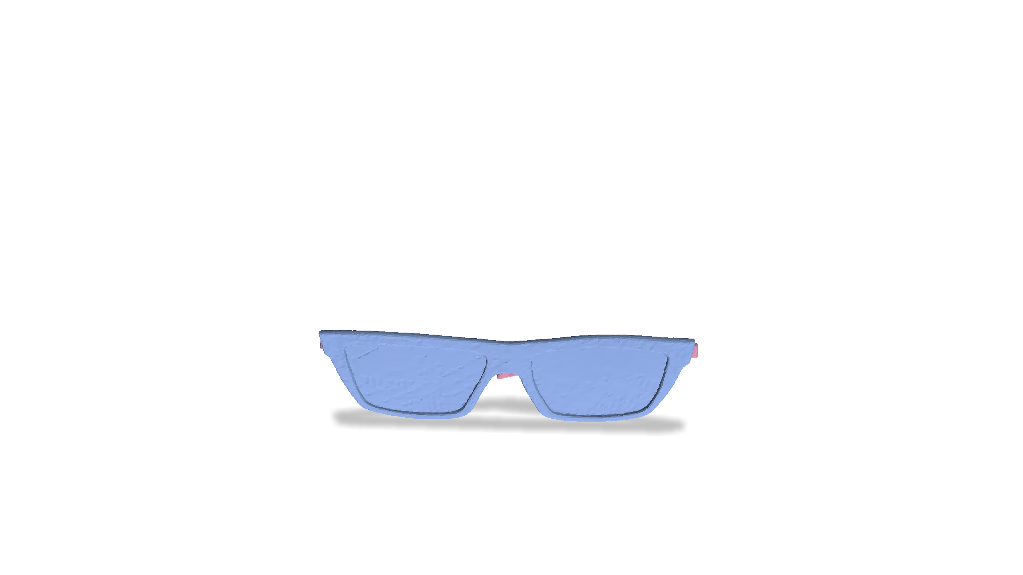
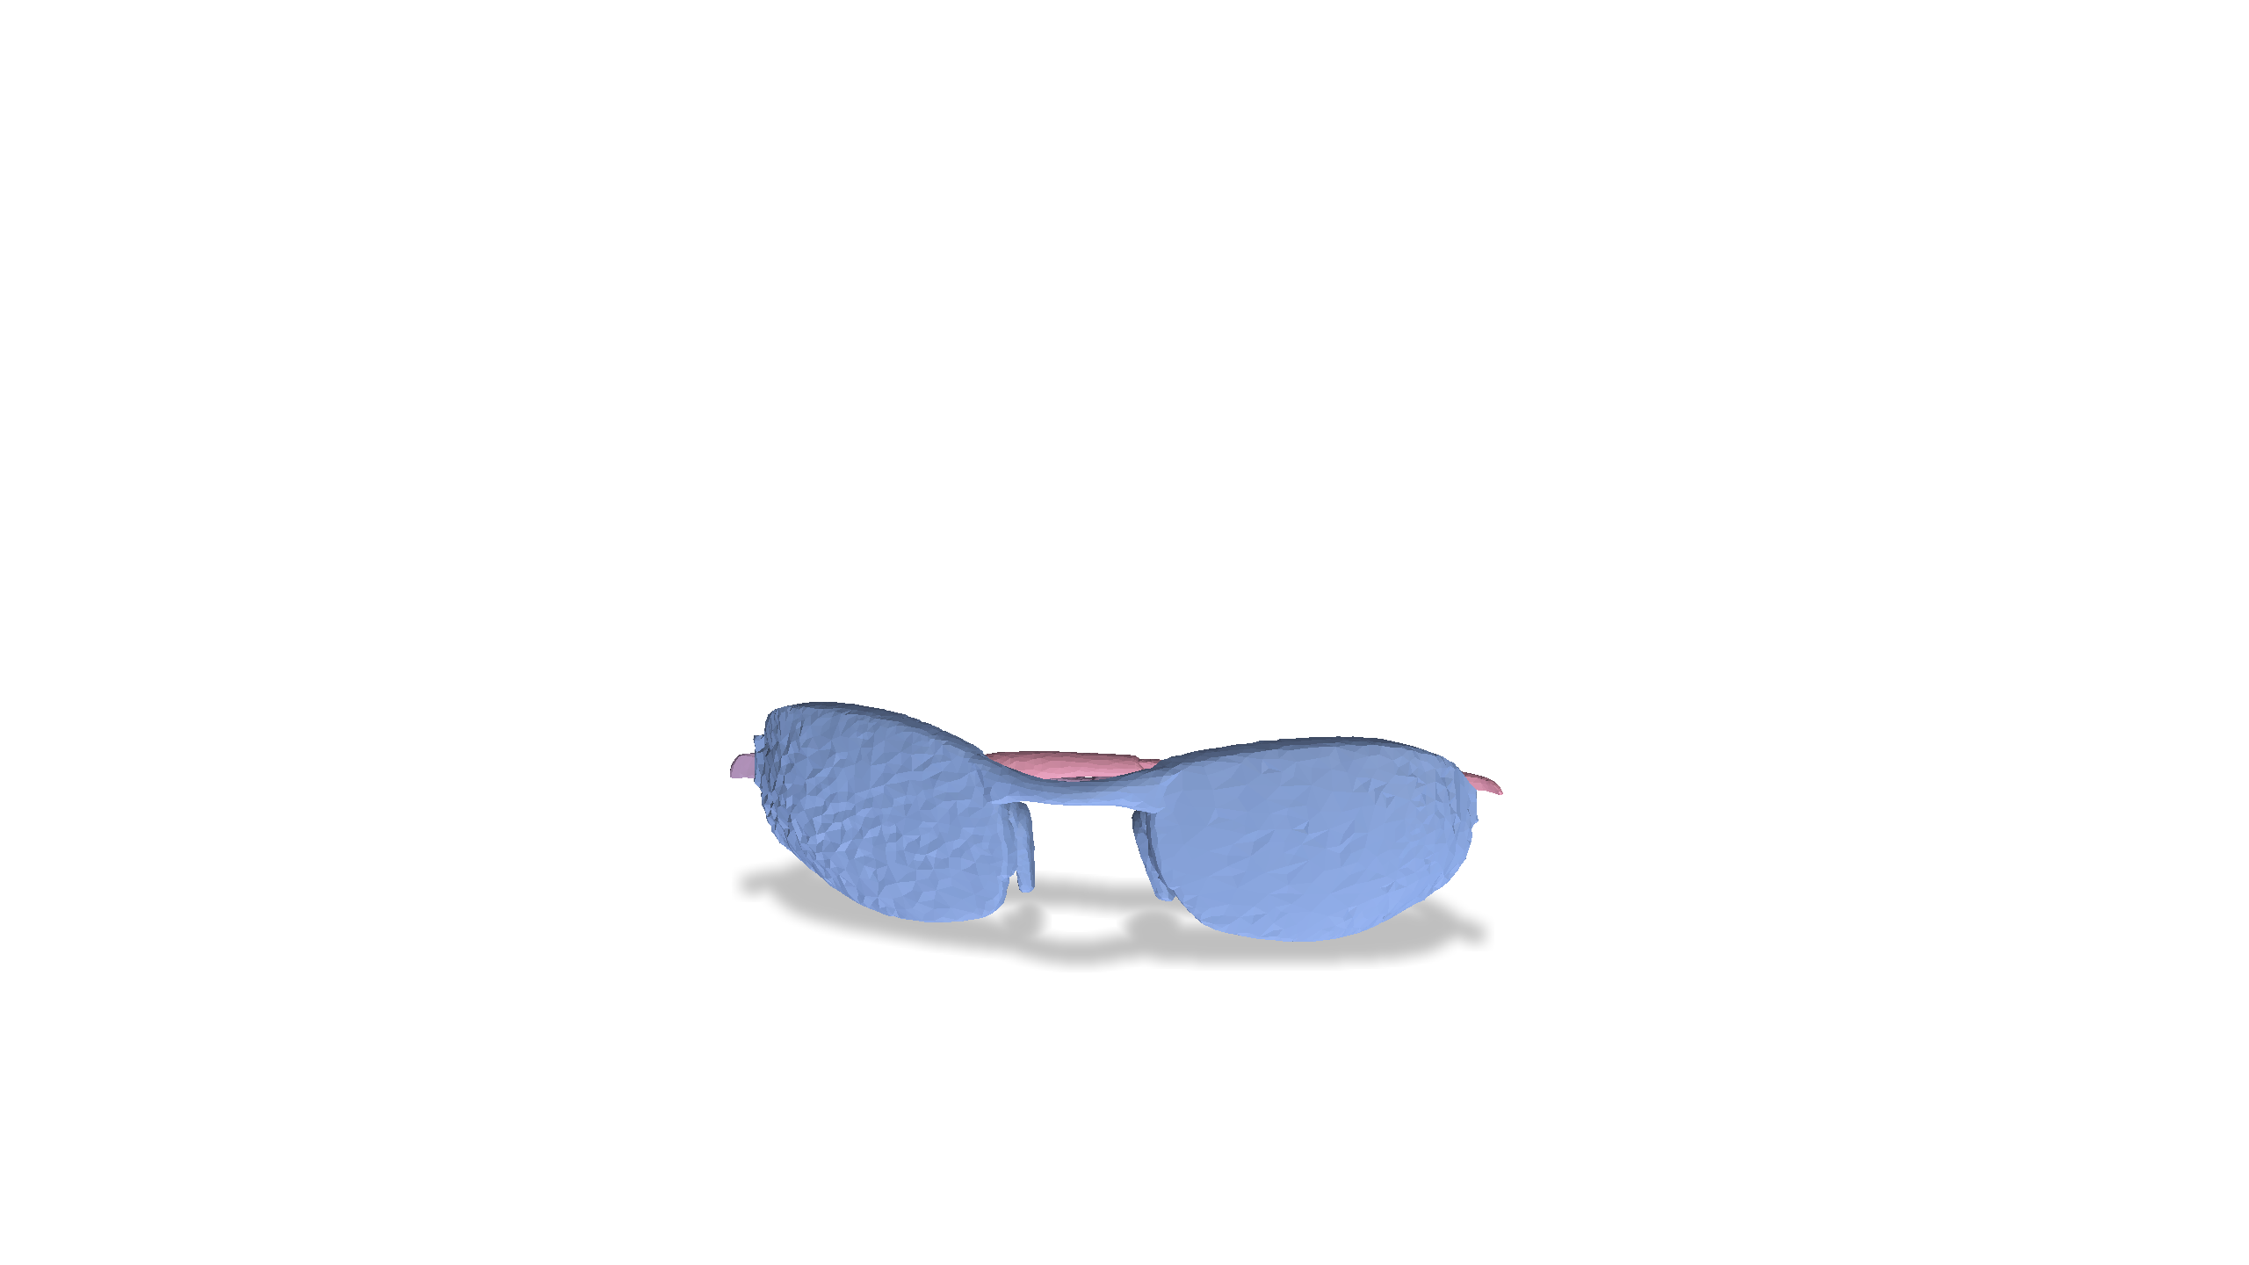
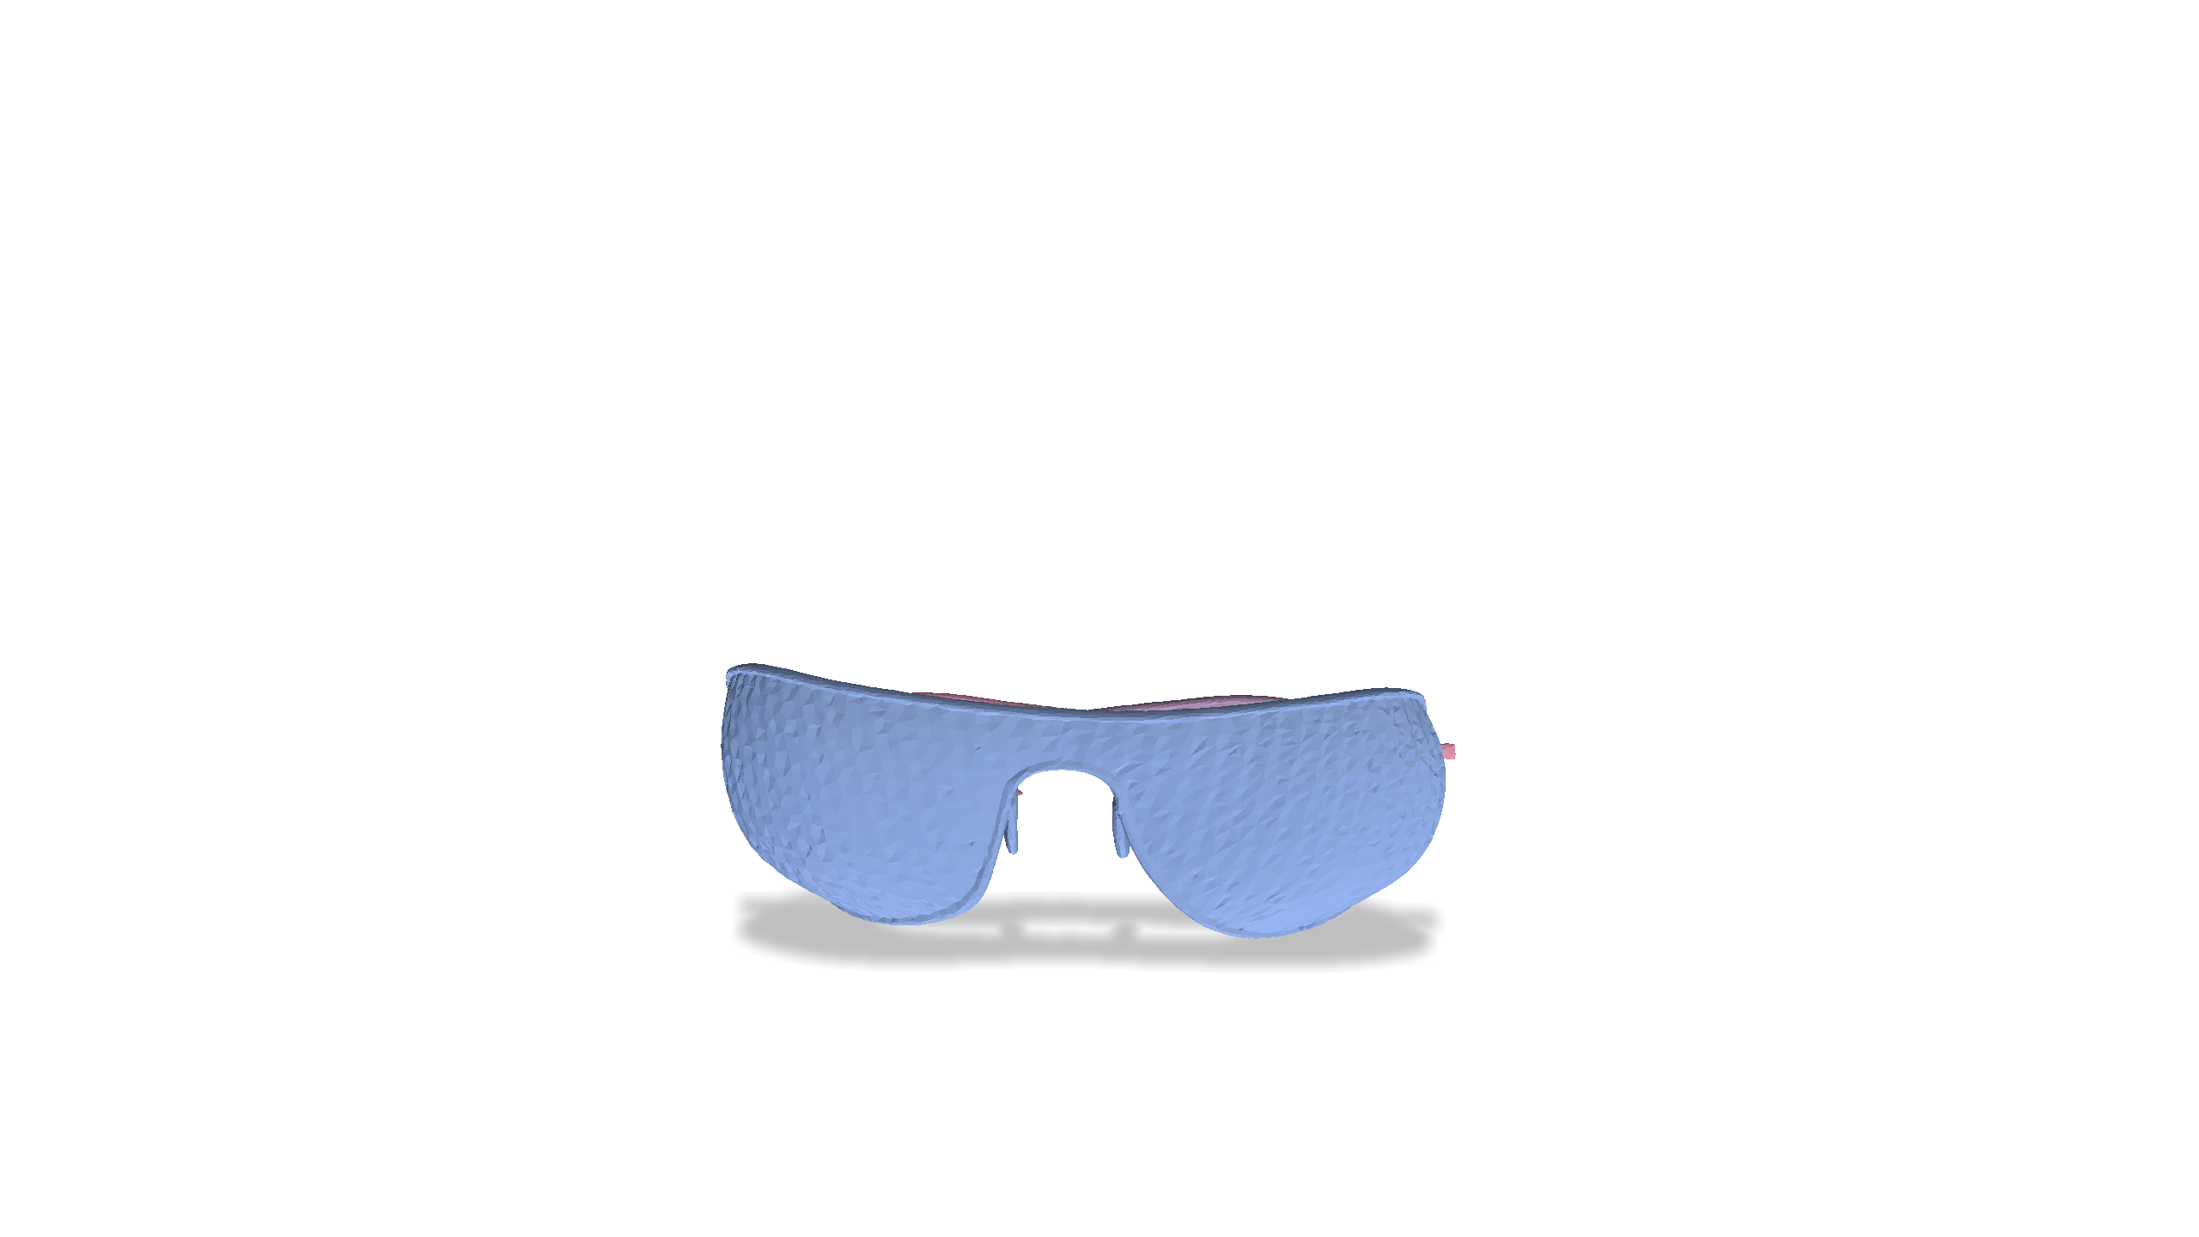
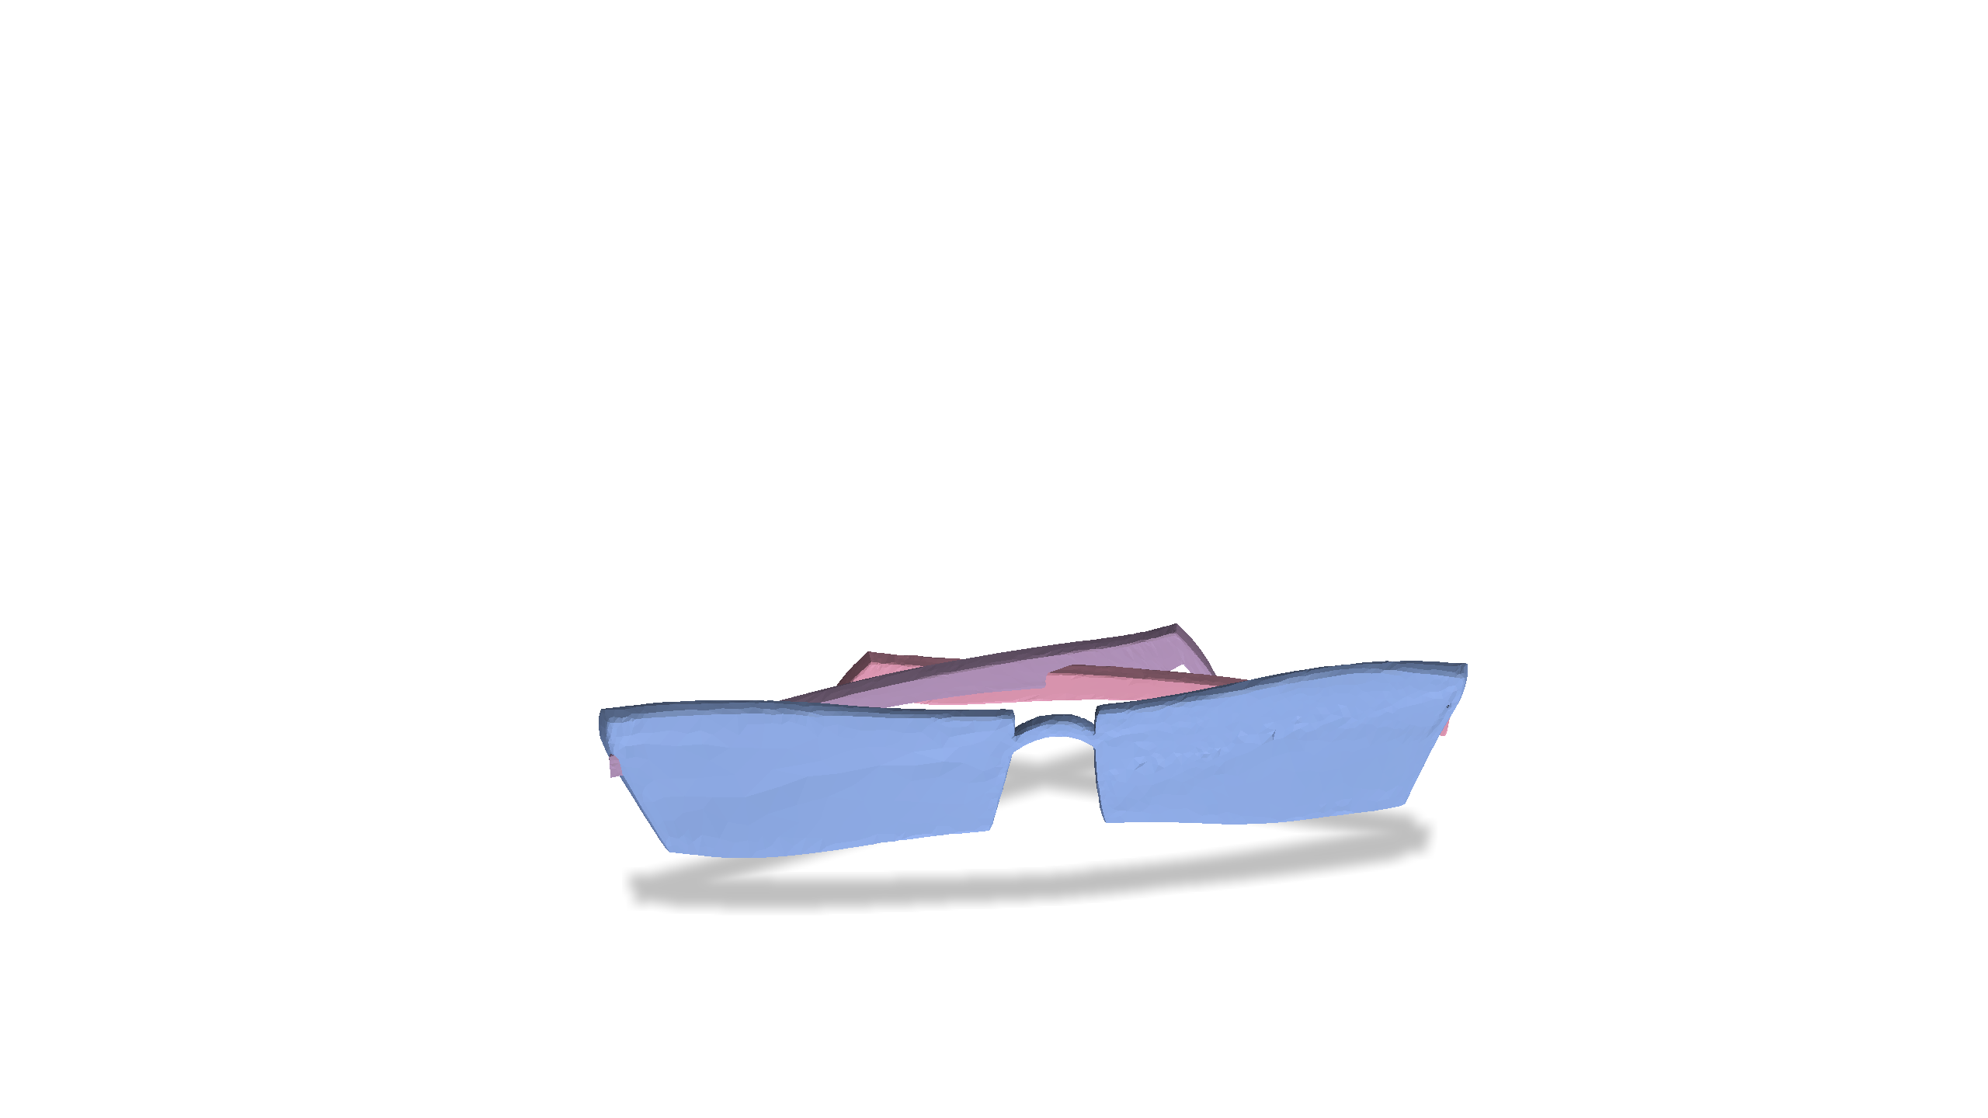
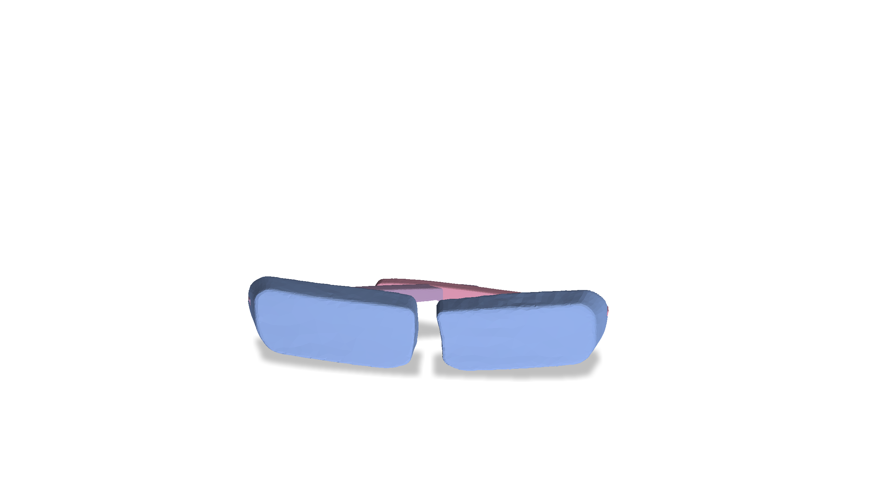
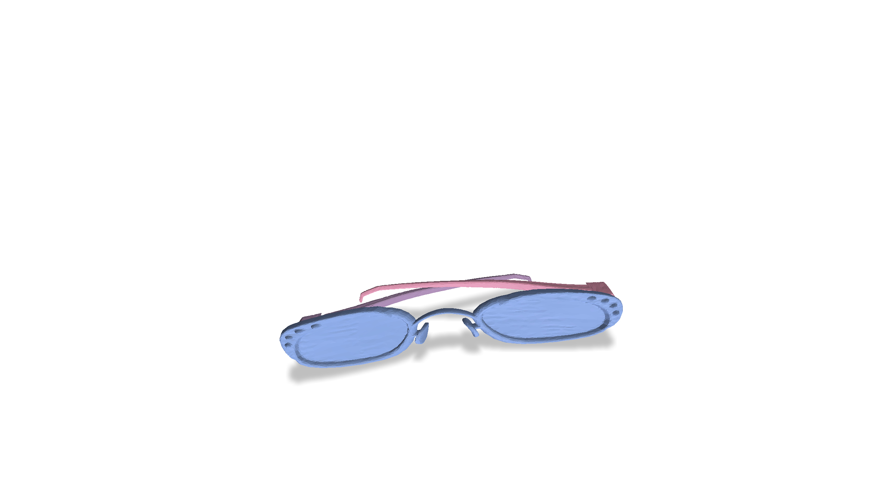
Problem Setting
Observed Examples
Physical Validity
Simulation Timestep $t_{4}$

Slide 9
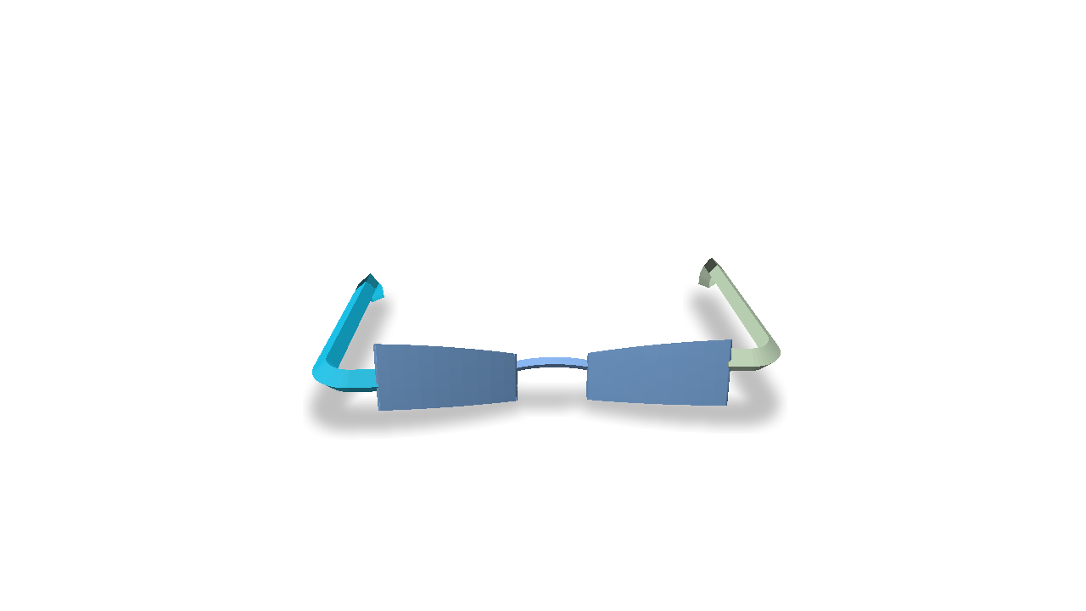
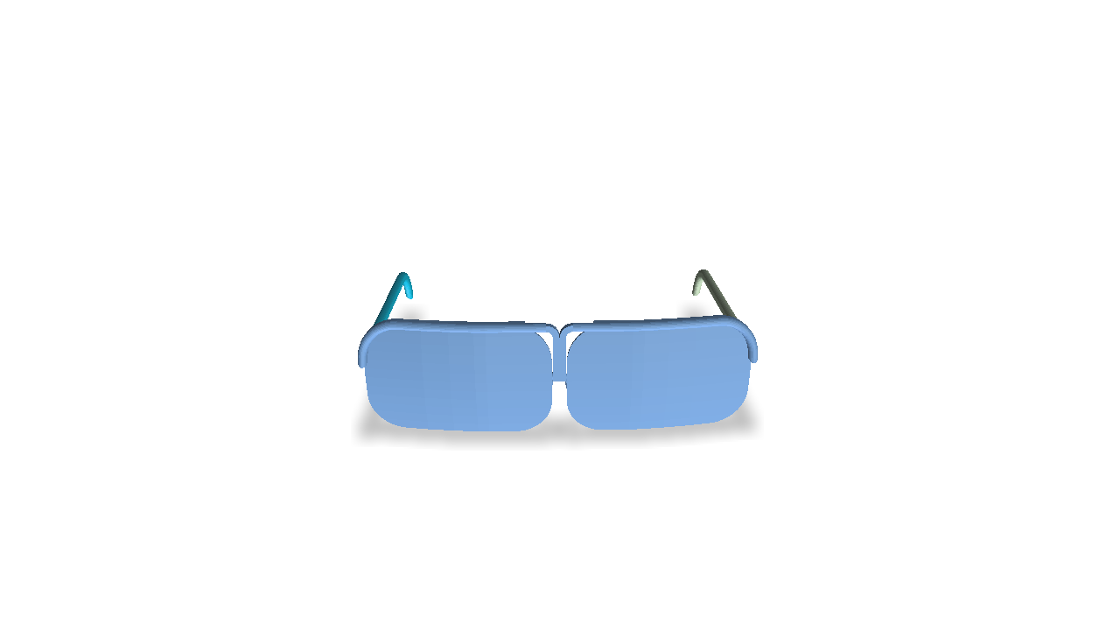
Challenges:
Few-shot generation
Physically-aware articulated mesh generation
Problem Setting
Observed Examples
Physical Validity
Simulation Timestep $t_{4}$
Notes:
Solving this task poses two main challenges, namely few-shot generation and physically-aware articulated mesh generation.

Slide 10
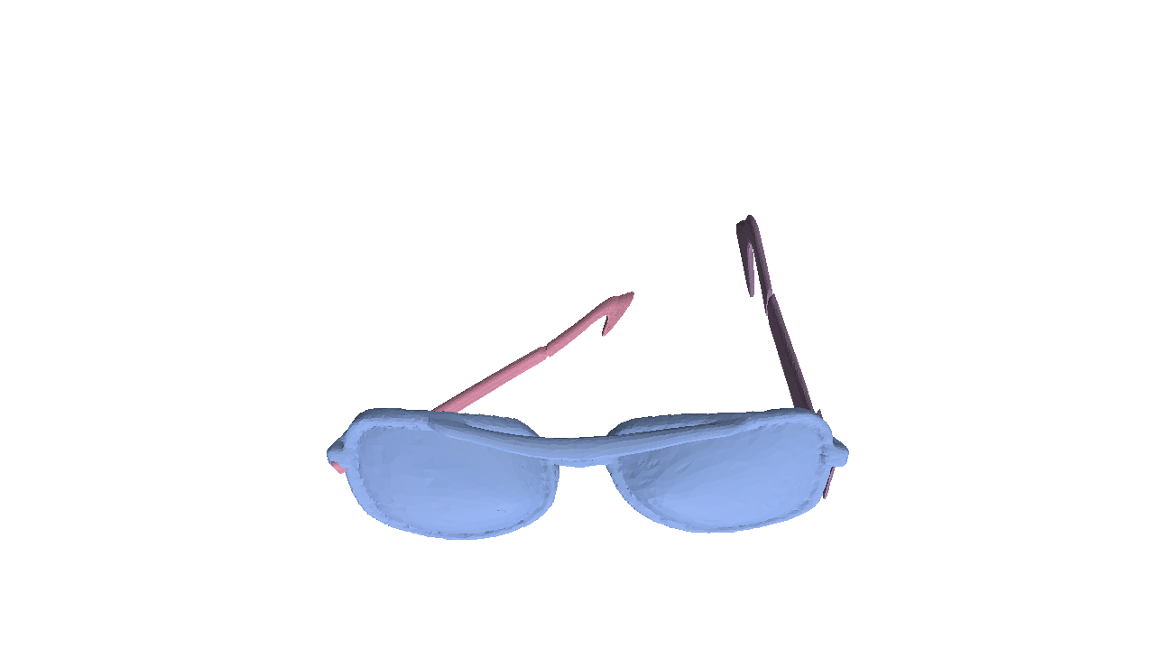
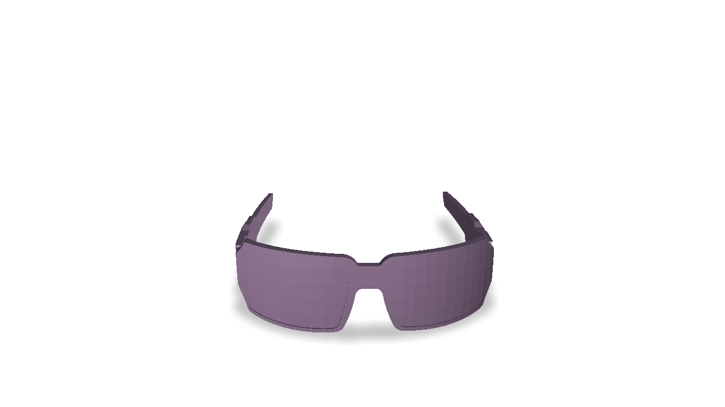
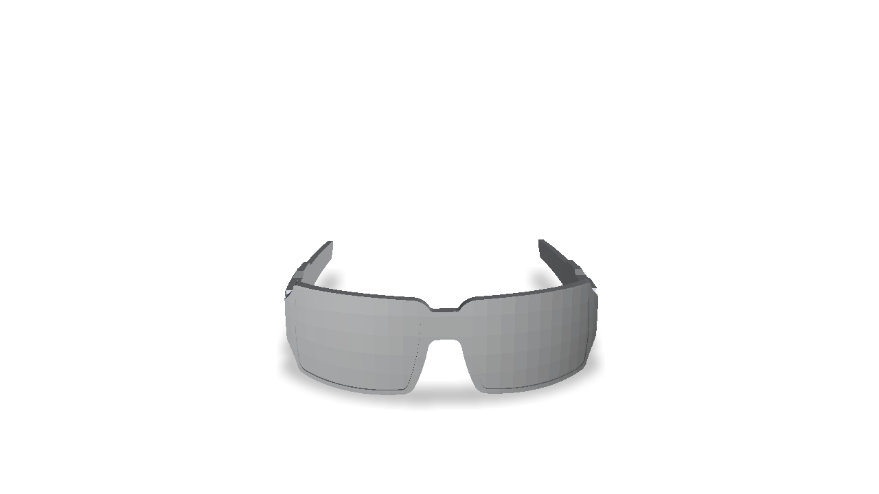
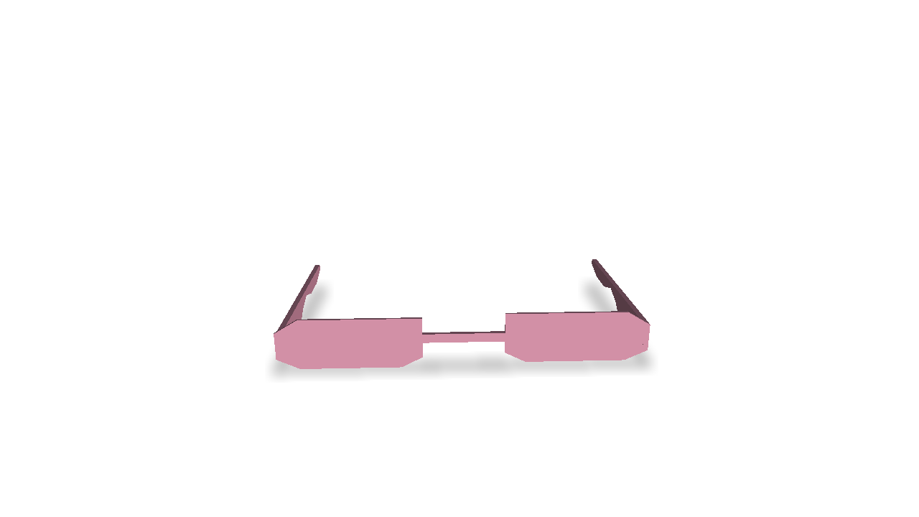
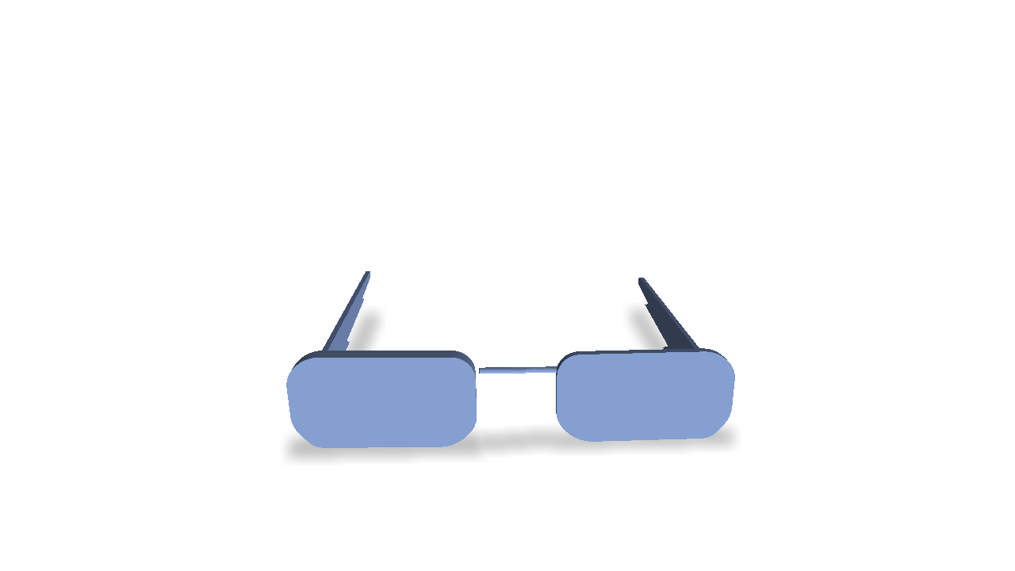
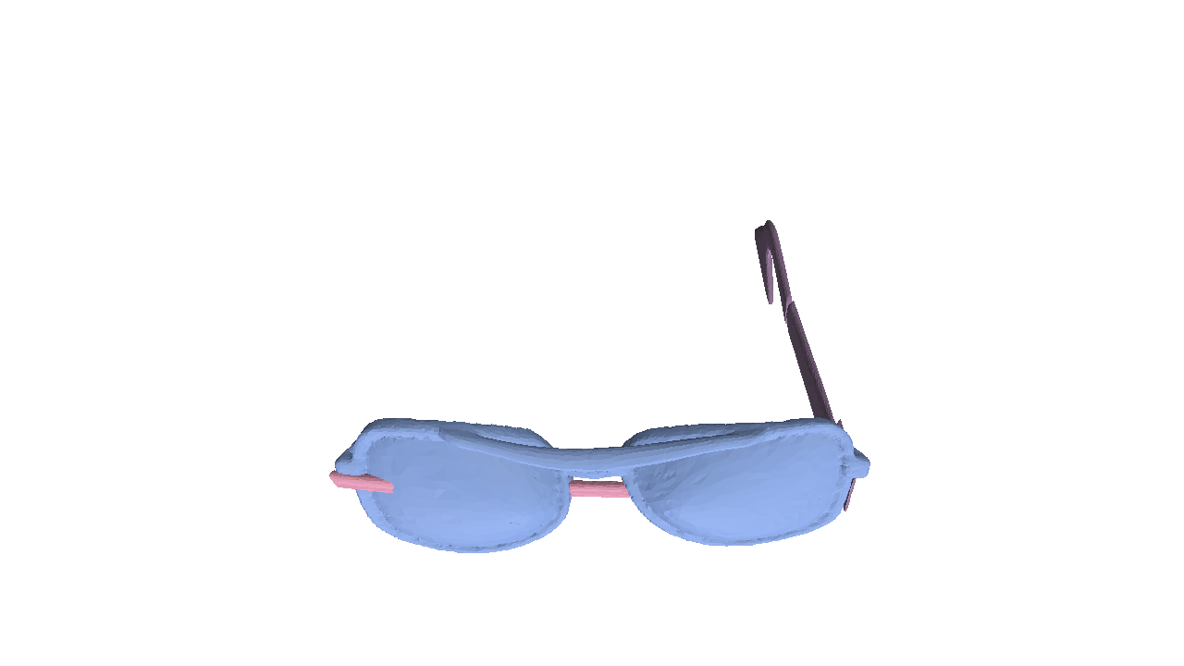
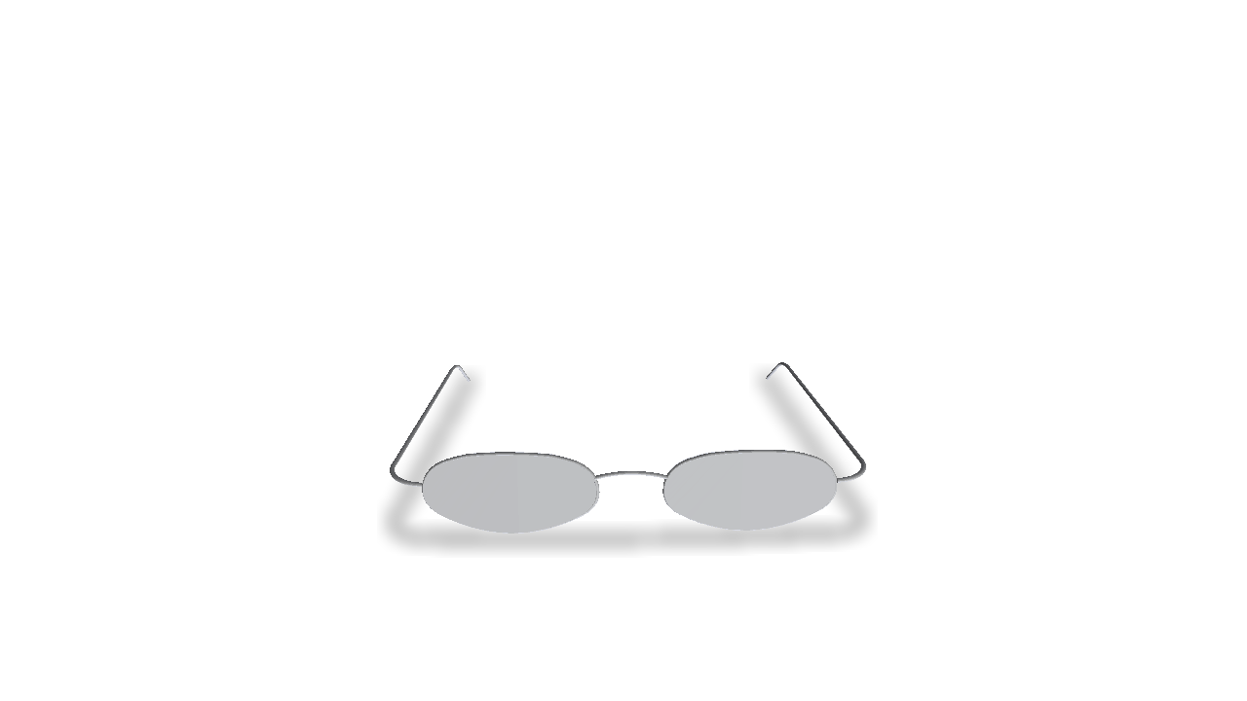
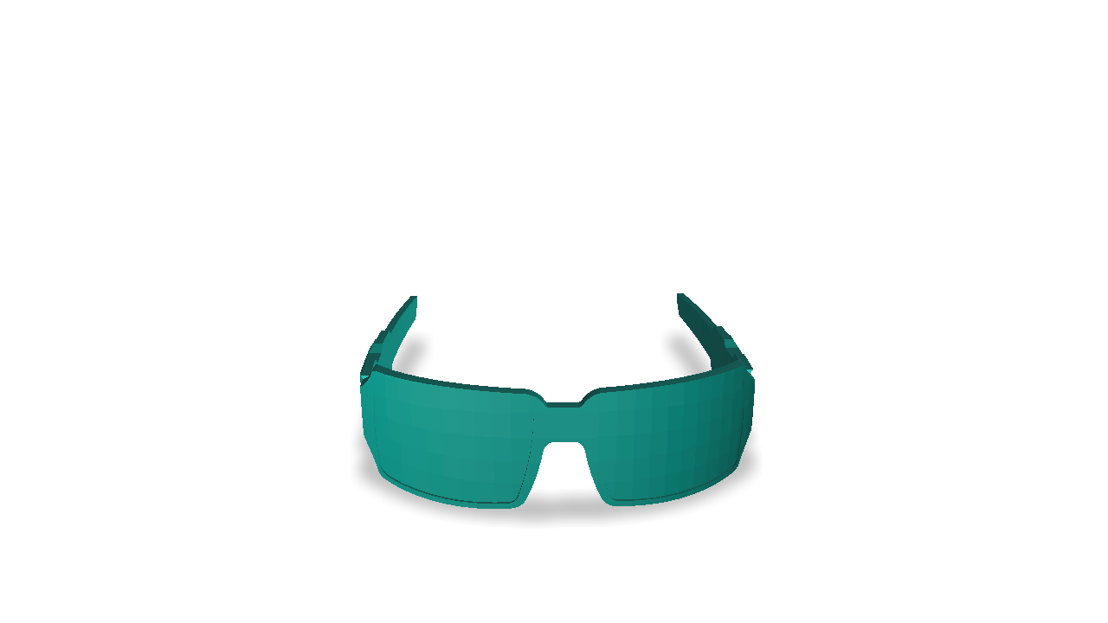
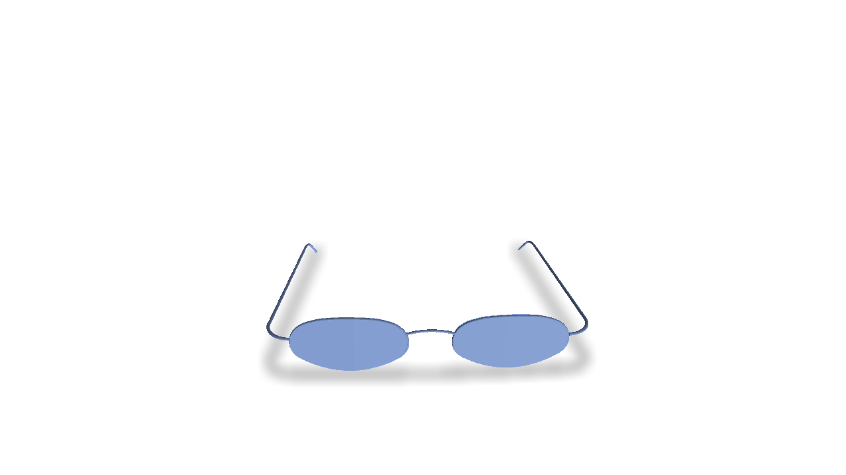
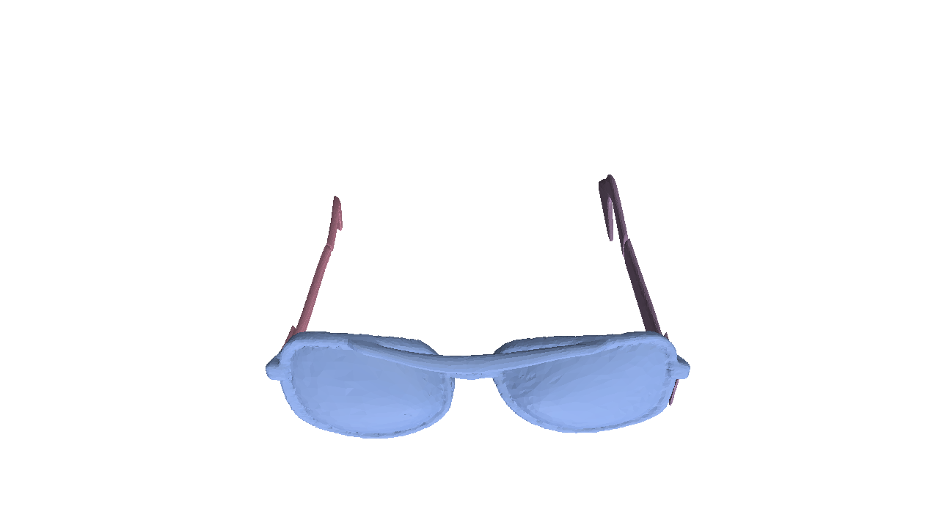
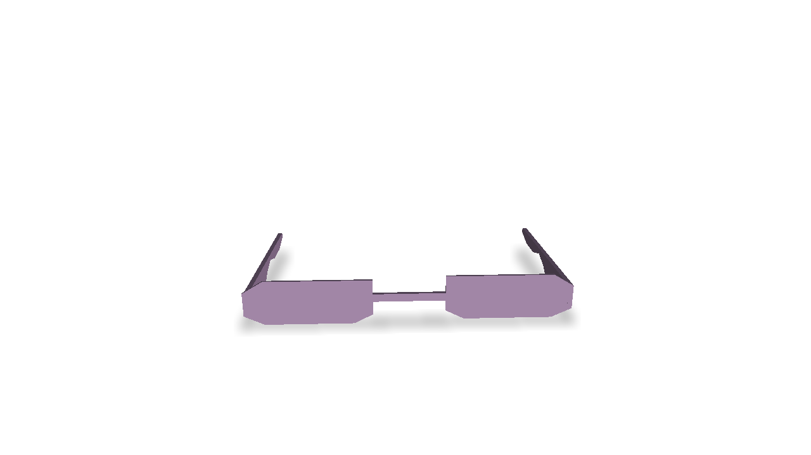
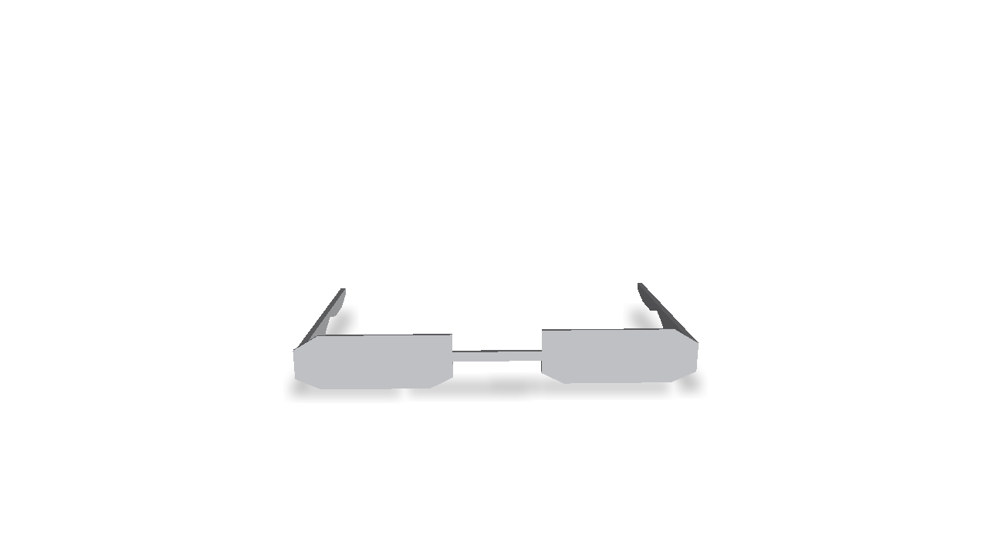
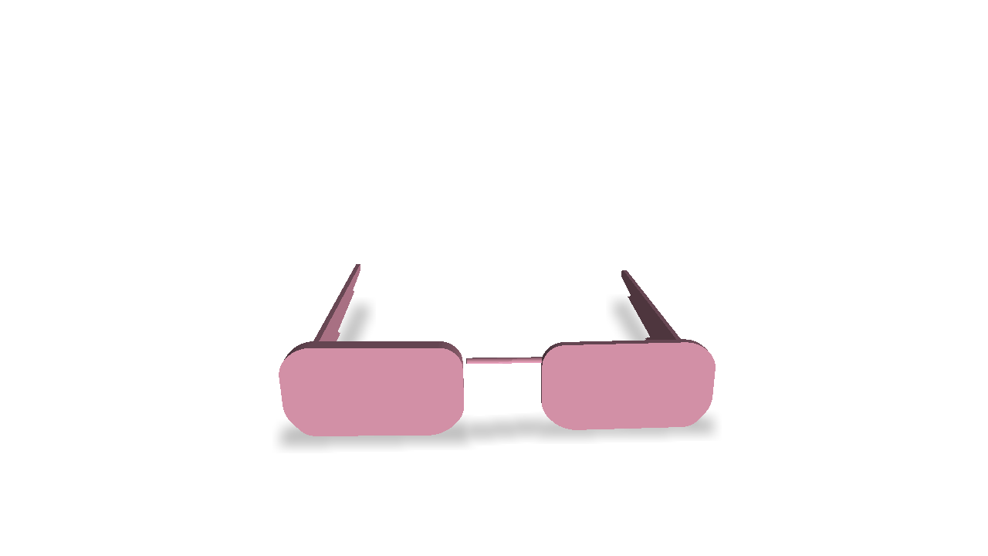
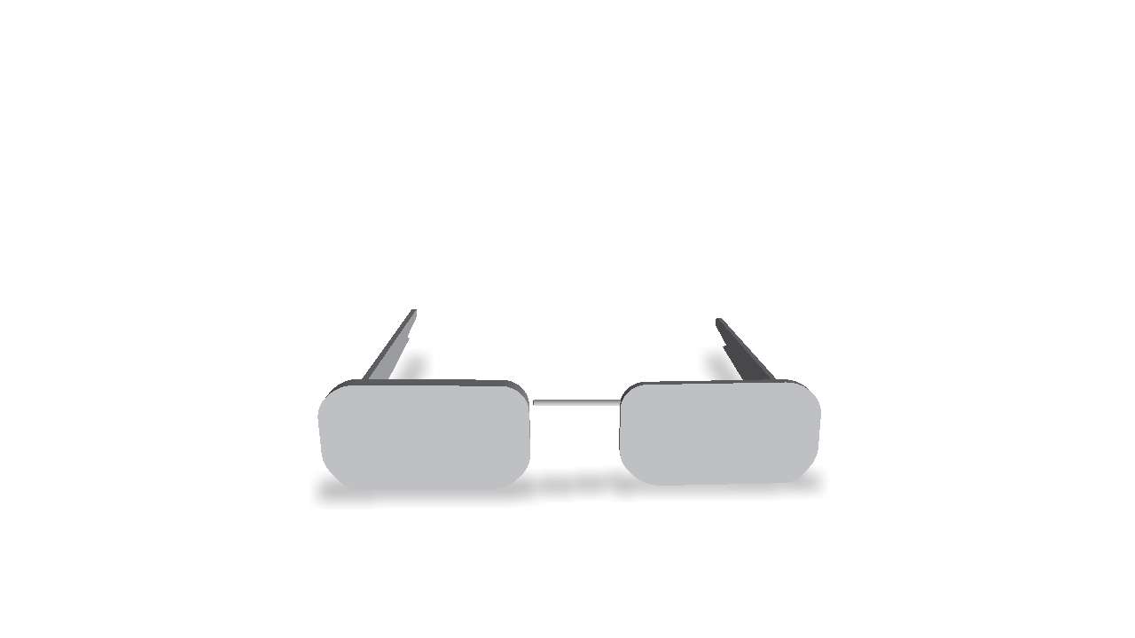
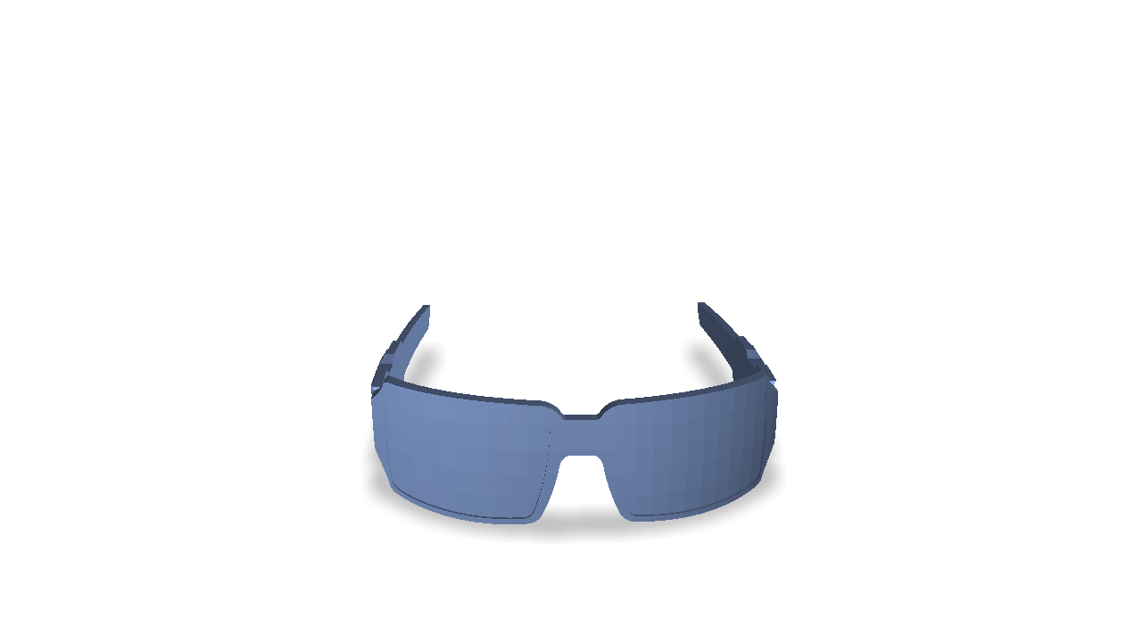
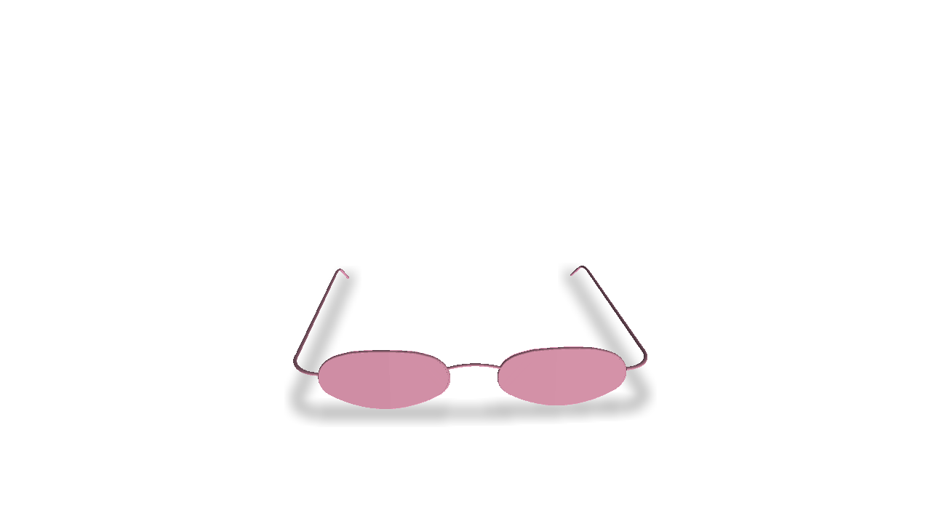
Challenges –
Few-Shot Articulated Mesh Generation
Physical Validity
Diversity
Notes:
Existing mesh generation techniques either cannot generate diverse meshes from a few examples or cannot model correct object-level constraints imposed by the functionality of their generated objects.

Slide 11
Hierarchical Mesh Deformation
Notes:
Our work designs a hierarchical mesh deformation-based generative model that tackles the aforementioned challenges using two key innovations, namely hierarchical mesh deformation and a physics-aware correction scheme.

Slide 12
Hierarchical Mesh Deformation
…
…
Hierarchical Deformation
Notes:
We propose an object-convex hierarchy.
Then the hierarchical mesh deformation is realized by learning a convex-level deformation-based generative model and further with a mesh deformation synchronization strategy to compose individual convex deformation spaces together to object-level spaces.

Slide 13
Learn and Transfer
Cross-Category Shared Deformation Patterns
Cross-Category Shared Deformation Patterns
Notes:
When learning the convex-level deformation model, we propose to transfer cross-category shared deformation patterns from large-scale rigid mesh datasets to the target articulated mesh dataset.

Slide 14
Learn and Transfer
Cross-Category Shared Deformation Patterns
Cross-Category Shared Deformation Patterns

Slide 15
Learn and Transfer
Cross-Category Shared Deformation Patterns
Common Deformation Modes
Notes:
We represent convex deformations via cages and record common deformation modes via deformation bases.
We train a neural network to parameterize deformation bases.

Slide 16
Learn and Transfer
Cross-Category Shared Deformation Patterns
Notes:
By pre-training it on rigid meshes and fine-tuning it on the target dataset, we can transfer shared deformation patterns to the category of interest for deformation space enrichment.

Slide 17
Convex Deformation Synchronization
Synchronized Deformations
$$min ℱ$$
Notes:
Given individual convex deformation spaces, instead of composing them together directly, we further propose a convex deformation synchronization strategy to capture object-level shape priors such as symmetric part geometry.
We estimate a set of synchronization transformation matrices such that we can replace convex-level deformation parameters with a single object-level deformation parameter.

Slide 18
Object-Level Deformation Model
$$z∼𝒫(⋅)$$
Notes:
We then use a mixture of Gaussian to model the distribution of object-level deformation parameters

Slide 19
Object-Level Deformation Model
$$z_{1}∼𝒫(⋅)$$

Slide 20
Object-Level Deformation Model
$$z_{2}∼𝒫(⋅)$$

Slide 21
Object-Level Deformation Model
$$z_{3}∼𝒫(⋅)$$

Slide 22
Physics-Aware Deformation Correction
Notes:
Further, we design a physics-aware deformation correction scheme to encourage the generative model to produce physically-realistic deformations and to improve the physical validity of synthesized meshes.

Slide 23
Physically-Aware Deformation Correction
Re-synthesize
Deformation Networks
Shape optimization
Physical penalty $ℒ_{C}$
Notes:
It is composed of a penetration depth-based penalty term measuring self-penetrations to provide physical supervision for the network, and a collision response-based shape optimization strategy to mitigate self-penetrations.

Slide 24
Physically-Aware Deformation Correction
Deformation Networks

Slide 25
Experimental Results
Notes:
Next, we present our experimental results.

Slide 26
Quantitative Evaluation
50.45
5.198
0.1118
1.3192
Notes:
For quantitative evaluation, our method can outperform baseline generative models by a large margin on both metrics measuring generative ability and physics metrics.

Slide 27
Eyeglasses
References (5-shots)
Notes:
We can generate a diverse asset of physically-aware articulated meshes by only observing a limited number of examples.

Slide 28
Eyeglasses
References (5-shots)

Slide 29
Scissors
References (4-shots)

Slide 30
Oven
TrashCan
(4-shots)
(4-shots)

Slide 31
Table
Airplane
(4-shots)
(4-shots)
Notes:
Moreover, our method can also be applied to rigid object categories for few-shot mesh generation.

Slide 32
Table
Airplane
(4-shots)
(4-shots)

Slide 33
Ablation Study
Notes:
We also conduct a series of ablation studies by validating the role of some crucial designs in our method, including hierarchical mesh deformation, transfer learning for the convex-level deformation model, physics-aware deformation correction scheme, and test time adaptation.
Each of them plays one of our core contributions.

Slide 34
Few-Shot Physically-Aware Articulated Mesh Generation
via Hierarchical Mesh Deformation
Thanks for watching!

